Slide 1
Kubernetes

Slide 2
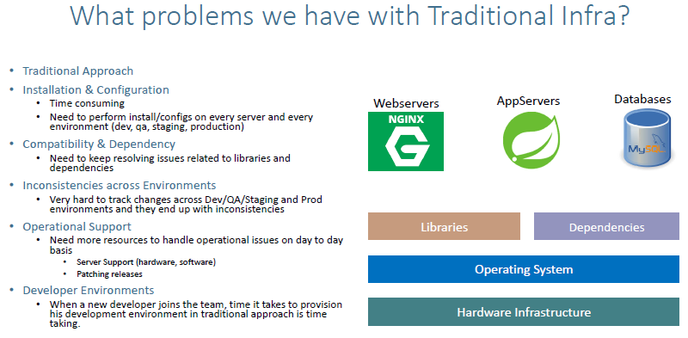
Docker:

Slide 3
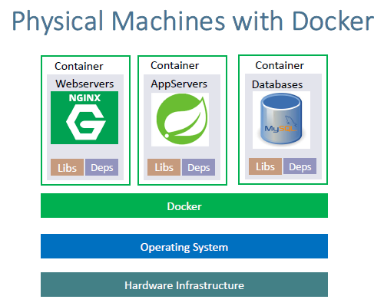
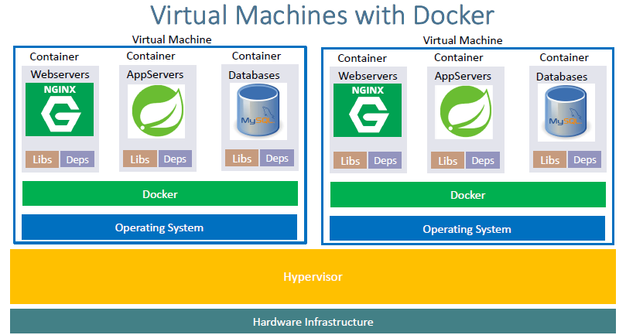
We have an os on the we are going to install Docker and then we are going to run the containers. Each container is a combination of its own libraries dependencies it will have its own os inside that and then we’ll be installing the engine or even the

Slide 4
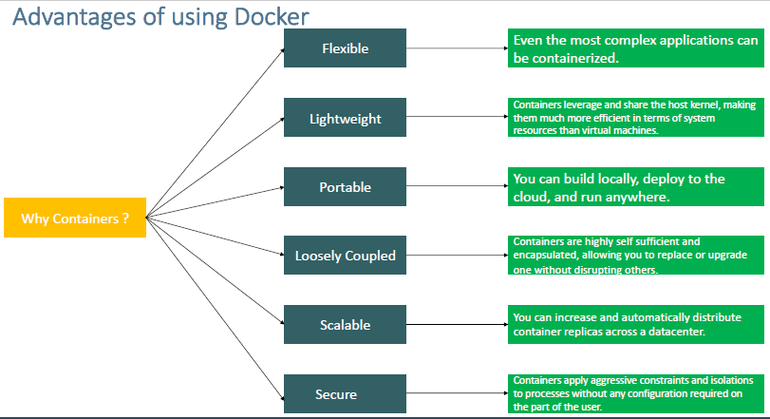

Slide 5
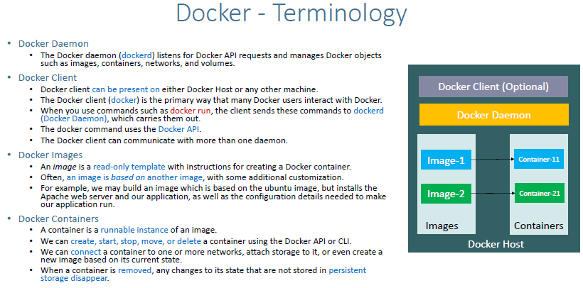

Slide 6
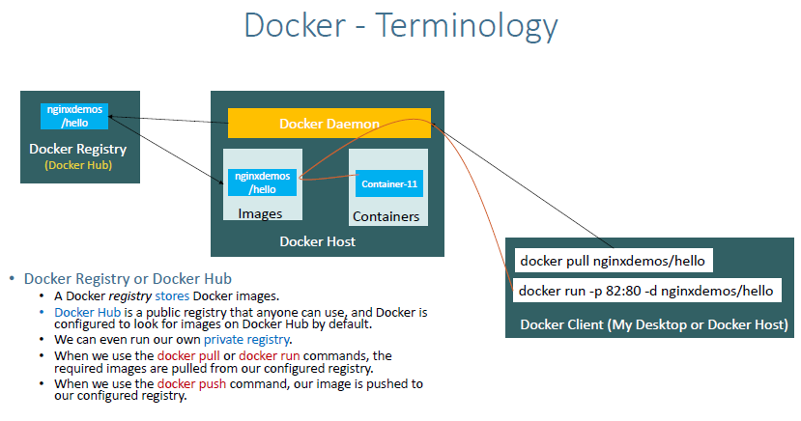

Slide 7
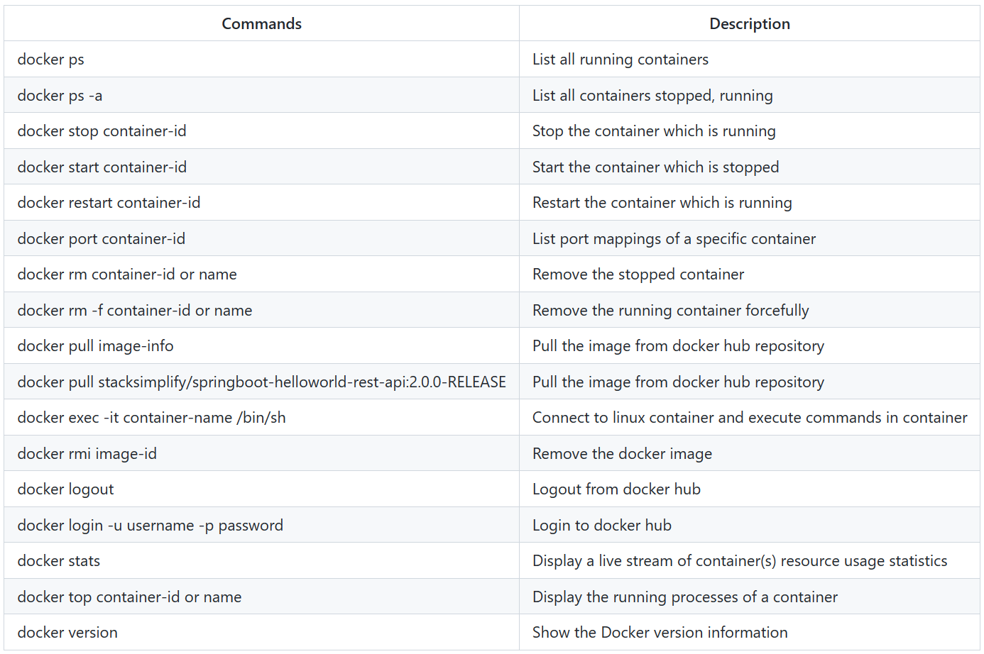

Slide 8
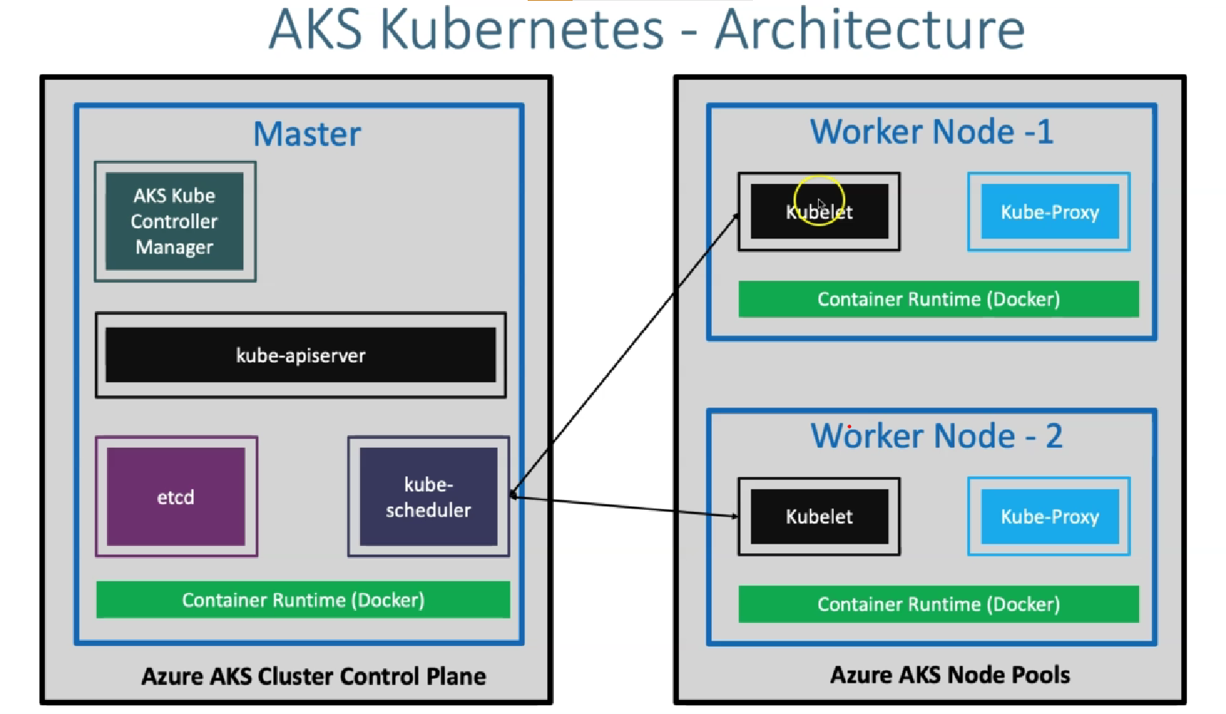

Slide 9
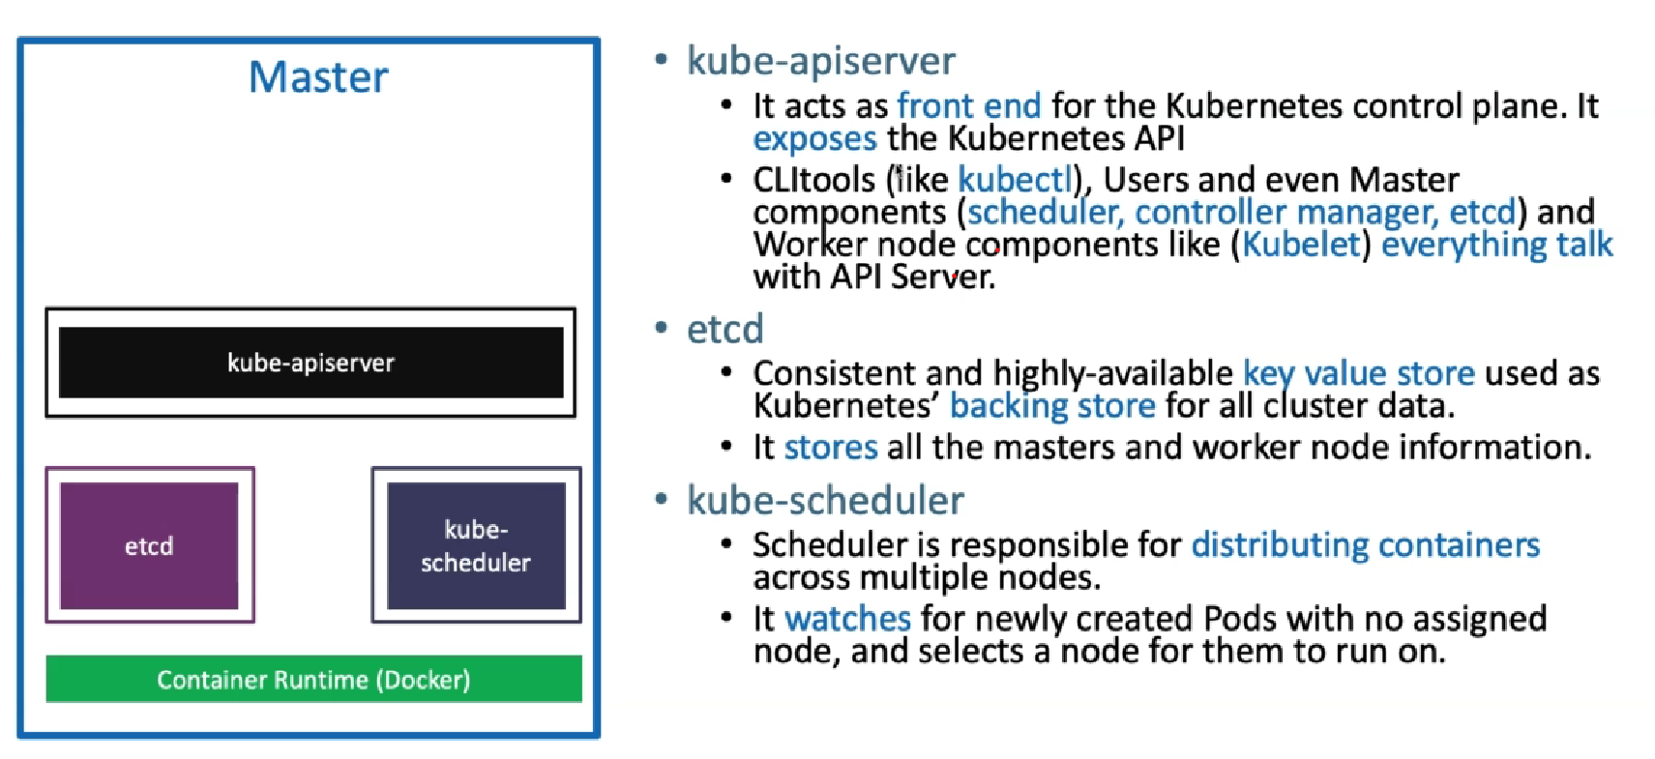

Slide 10
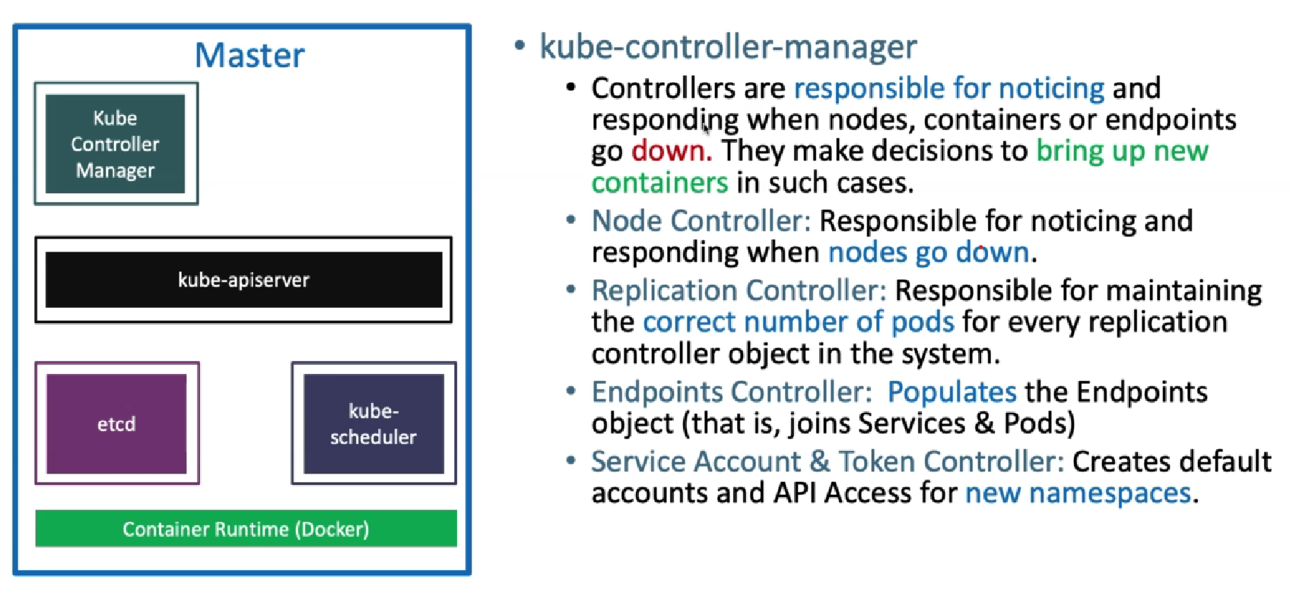

Slide 11
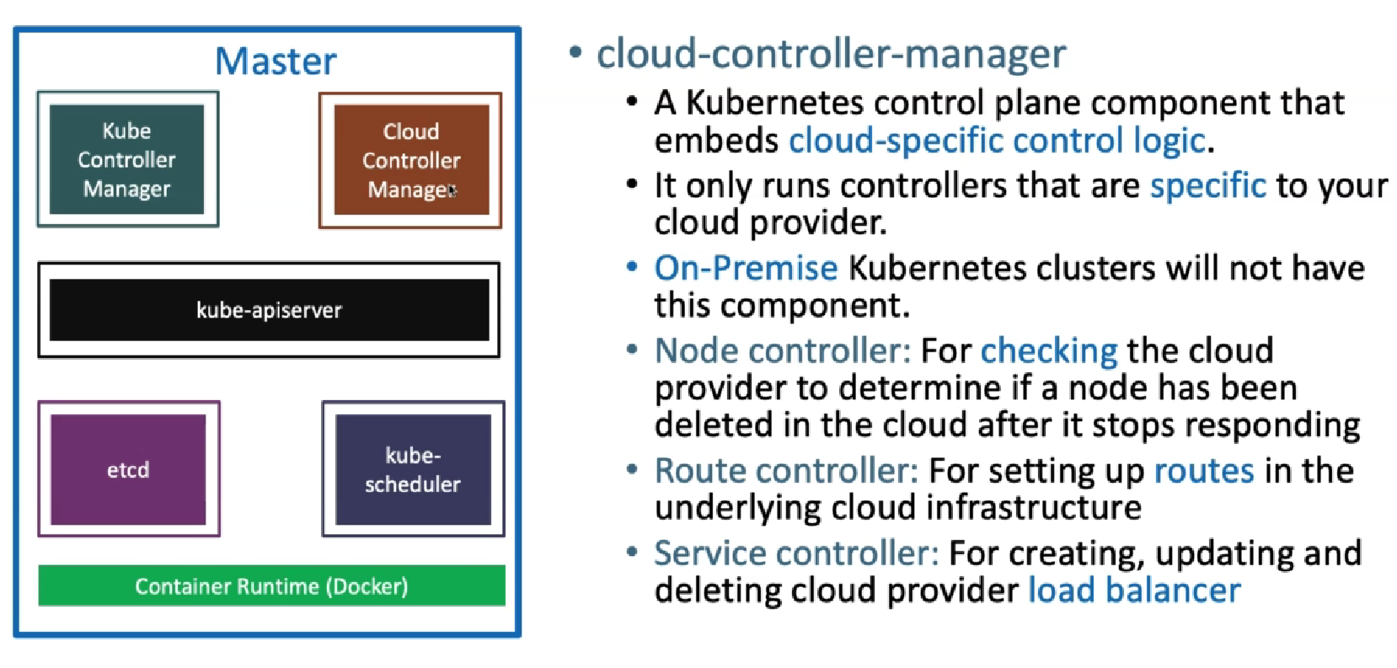

Slide 12
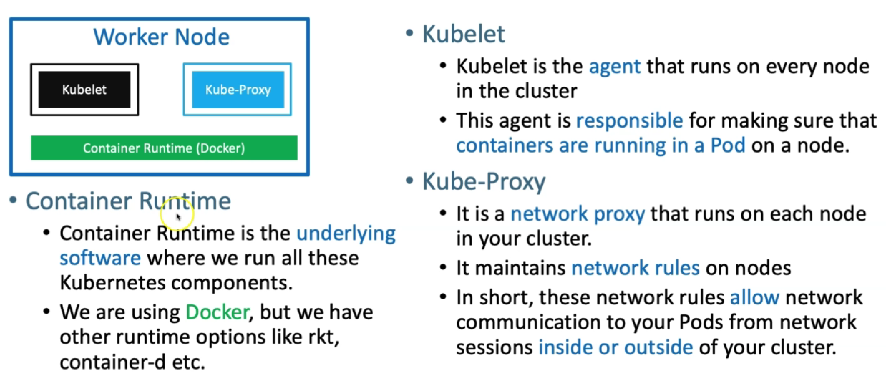

Slide 13
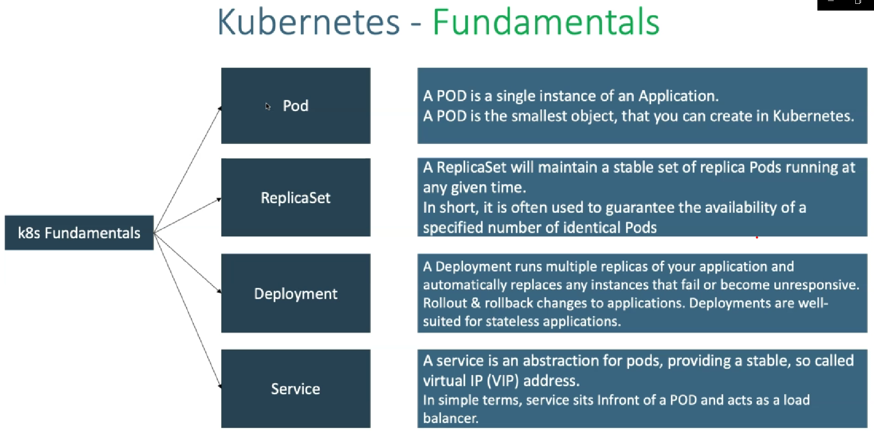
Kubernetes fundamentals:

Slide 14
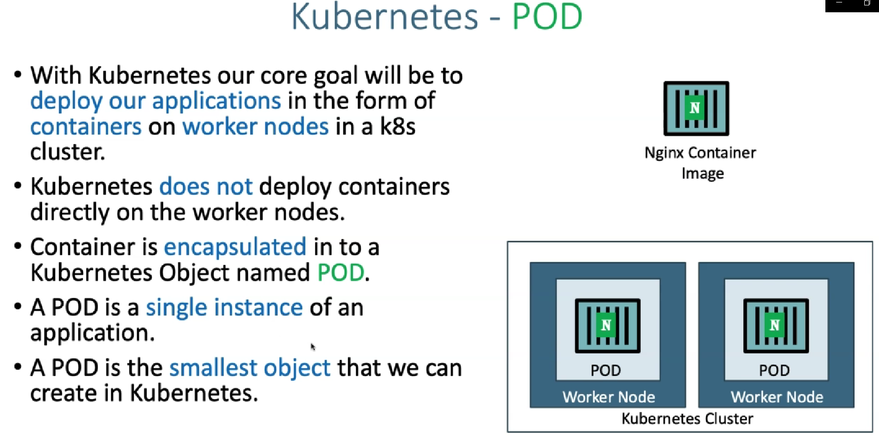

Slide 15
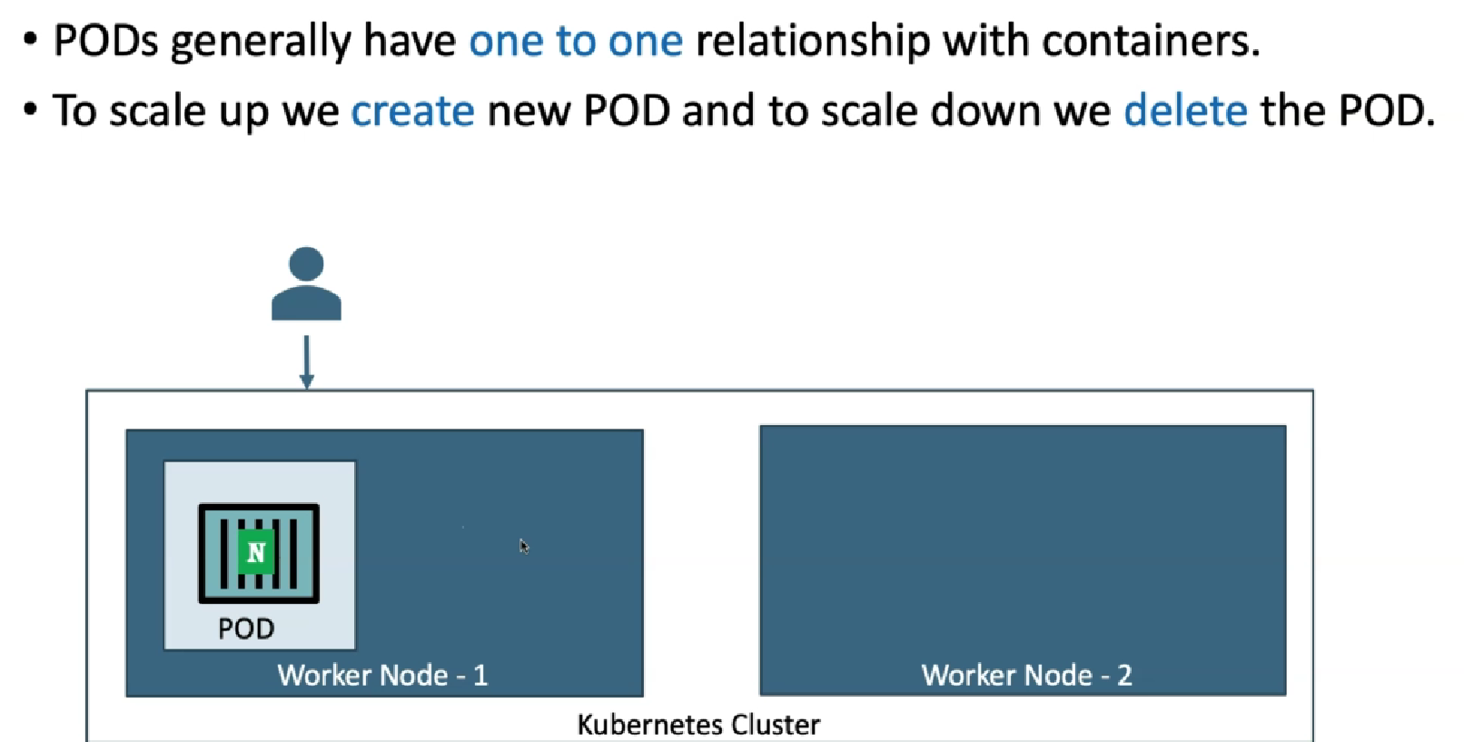

Slide 16
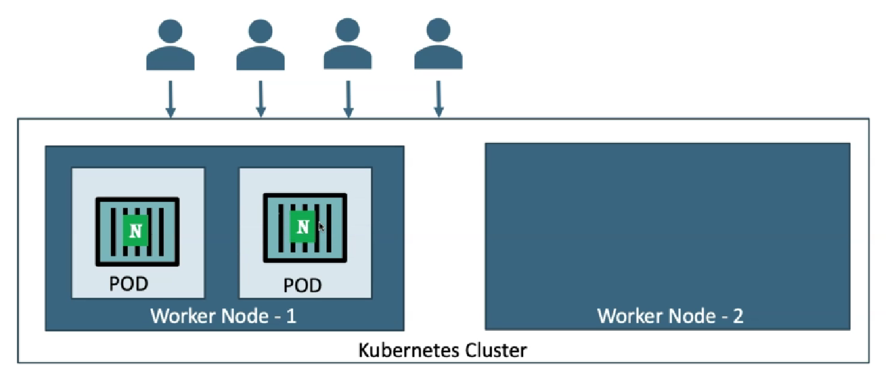
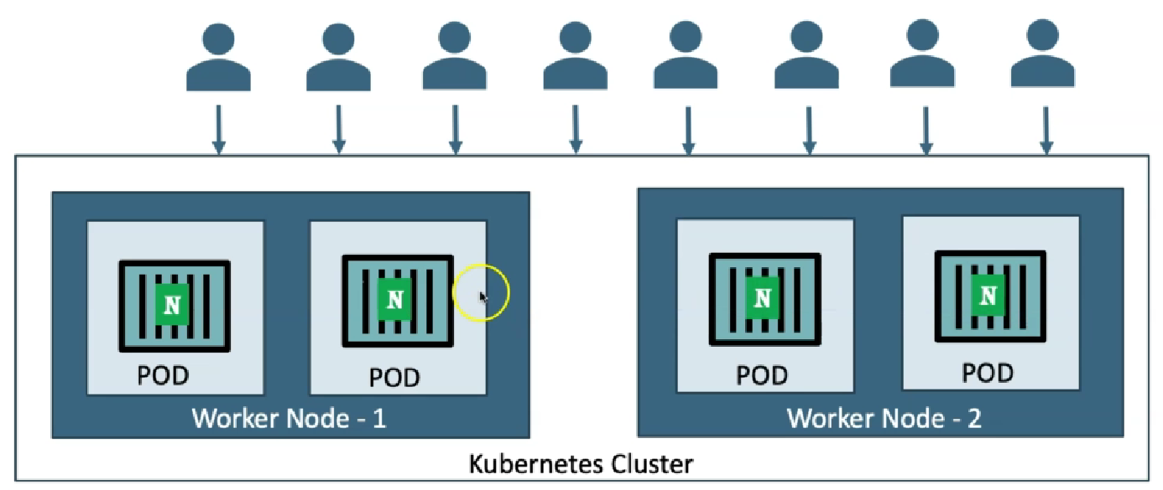
If traffic keeps growing, we need to add more pods for scaling our application. Like below shown. That is to scale up we create new pods and scale down we delete the pod.

Slide 17
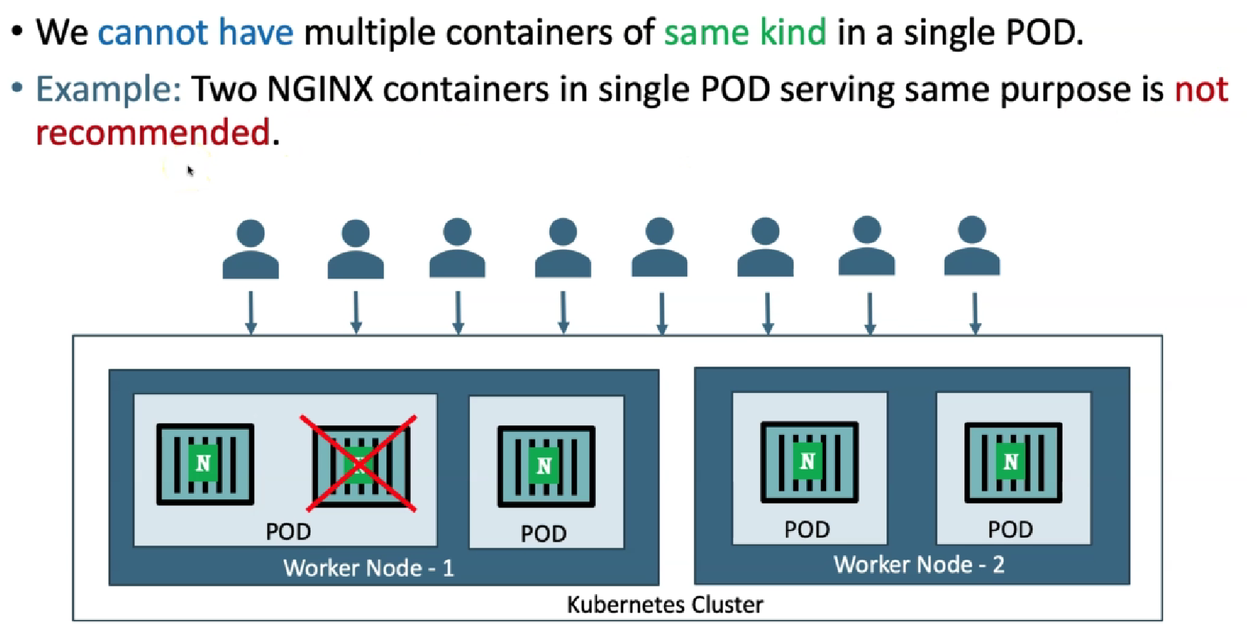
If traffic keeps going, here we can not scale the container inside a pod instead we need to scale the pods

Slide 18
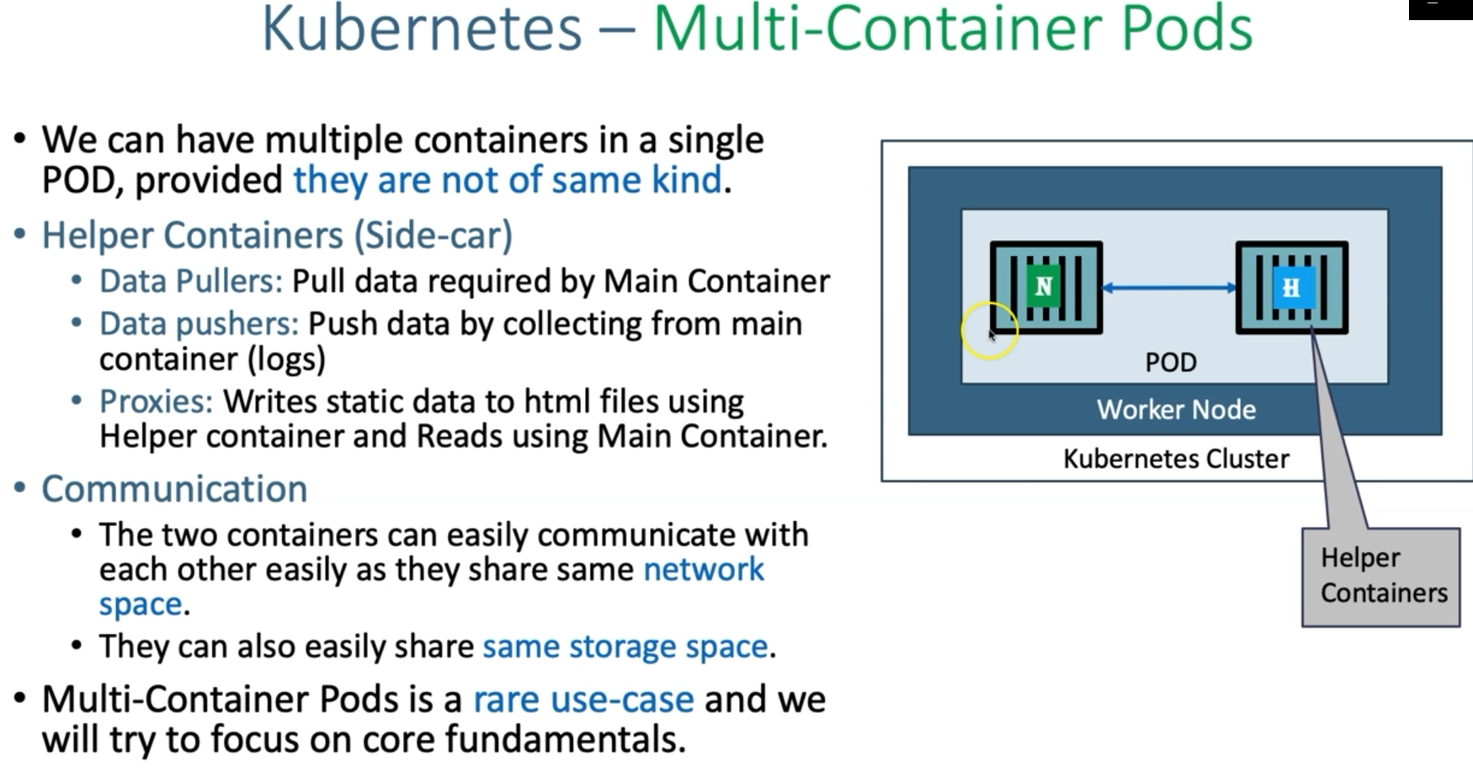

Slide 19
#To get worker node status
- Kubectl get nodes
- Kubectl get nodes –o wide
Create a Pod
# Template
kubectl run <desired-pod-name> --image <Container-Image>
# Replace Pod Name, Container Image
- kubectl run my-first-pod --image stacksimplify/kubenginx:1.0.0
Get the list of pods
# List Pods
kubectl get pods
# Alias name for pods is po
- kubectl get po
List Pods with wide option
List pods with wide option which also provide Node information on which Pod is running
- kubectl get pods -o wide

Slide 20
What happened in the backgroup when above command is run?
Kubernetes created a pod
Pulled the docker image from docker hub
Created the container in the pod
Started the container present in the pod
Describe Pod
Describe the POD, primarily required during troubleshooting.
Events shown will be of a great help during troubleshooting.
Describe command provides all details about the componat.

Slide 21
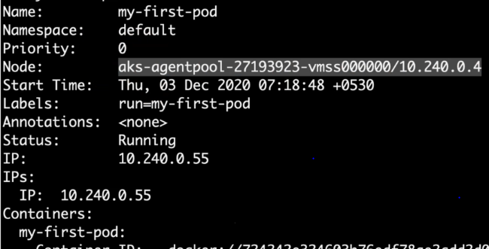
# Describe the Pod
kubectl describe pod <Pod-Name>
kubectl describe pod my-first-pod
Access Application
• Currently we can access this application only inside worker nodes.
• To access it externally, we need to create a NodePort or Load Balancer Service.
• Services is one very very important concept in Kubernetes.
Delete Pod
# To get list of pod names
kubectl get pods
# Delete Pod
kubectl delete pod <Pod-Name>
kubectl delete pod my-first-pod

Slide 22
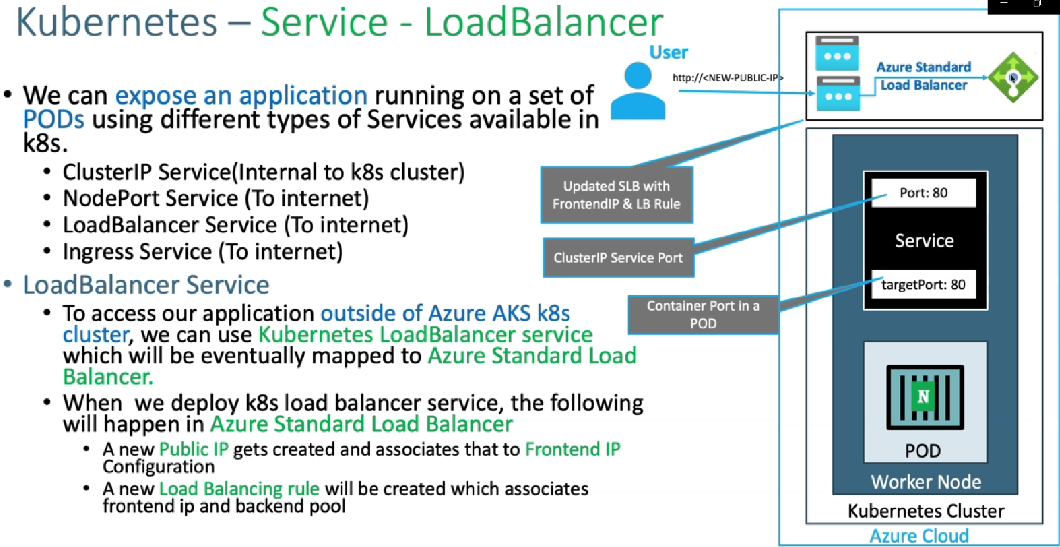
Step-03: Load Balancer Service Introduction
What are Services in k8s?
What is a Load Balancer Service?
How it works?
TargetPort is nothing but a container Port in a pod.
When user access the new public IP, the request goes vis public IP to the load balcance and then backend configuration go to the respective service using port number and the the request send to target port which is connect to the pod.
when ever a you create a node port or load balancer by default a cluster IP will get created and if you want to exposed as the external world then you call the type as the load balancer service. But the concept inside that is like port and then target port is common for all these things.

Slide 23
Step-04: Demo - Expose Pod with a Service
Expose pod with a service (Load Balancer Service) to access the application externally (from internet)
Ports
port: Port on which node port service listens in Kubernetes cluster internally
targetPort: We define container port here on which our application is running.
Verify the following before LB Service creation
Azure Standard Load Balancer created for Azure AKS Cluster
Frontend IP Configuration
Load Balancing Rules
Azure Public IP Addresses.
# Create a Pod
kubectl run <desired-pod-name> --image <Container-Image>
kubectl run my-first-pod --image stacksimplify/kubenginx:1.0.0
# Expose Pod as a Service
kubectl expose pod <Pod-Name> --type=LoadBalancer --port=80 --name=<Service-Name>
kubectl expose pod my-first-pod --type=LoadBalancer --port=80 --name=my-first-service
# Get Service Info
kubectl get service
kubectl get svc
# Describe Service
kubectl describe service my-first-service
# Access Application
http://<External-IP-from-get-service-output>
Verify the following after LB Service creation
Azure Standard Load Balancer created for Azure AKS Cluster
Frontend IP Configuration
Load Balancing Rules
Azure Public IP
View the resources in Azure AKS Cluster - Resources section from Azure Portal Management Console

Slide 24
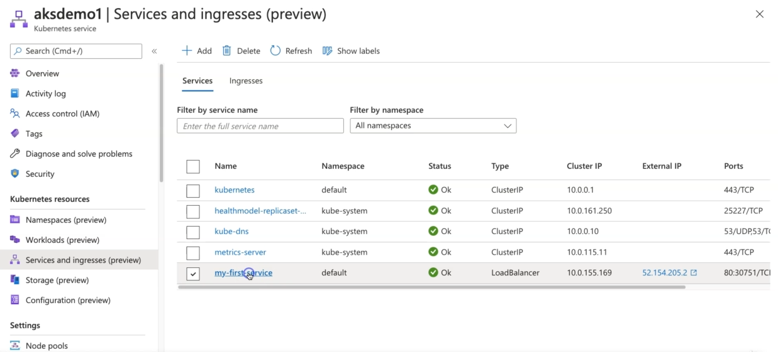
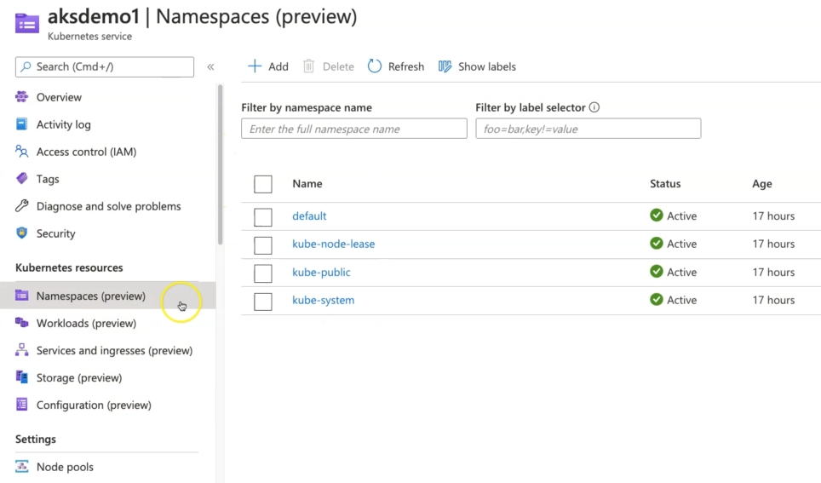
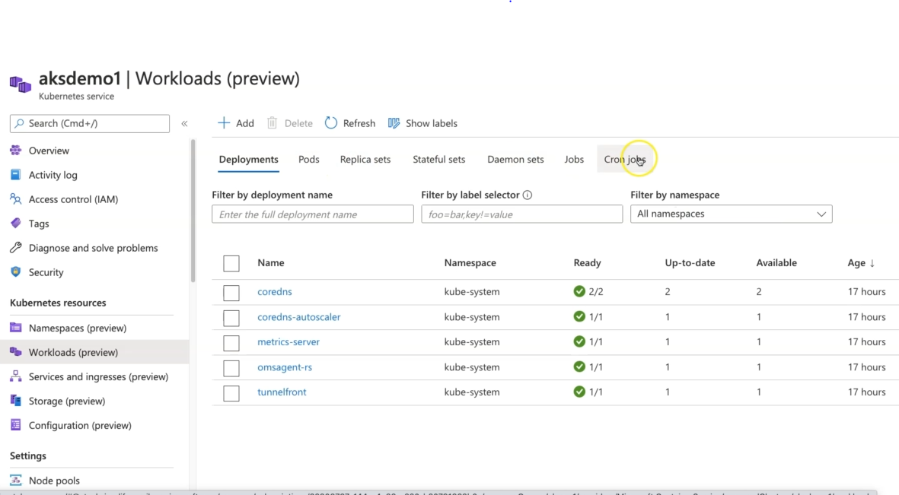
“Kubectl get namespaces” command we can use but in azure it is giving a user interface
“kubeclt get deployment” to show what are deployments are ruuning (workloads)
“kubectl get service or kubectl get svc”

Slide 25
Step-05: Interact with a Pod
Verify Pod Logs
# Get Pod Name
- kubectl get po
# Dump Pod logs
- kubectl logs <pod-name>
- kubectl logs my-first-pod
# Stream pod logs with -f option and access application to see logs.
- kubectl logs <pod-name>
kubectl logs -f my-first-pod
Note: To troble shoot the pods, There are two ways to interact with the pods.
Verify the logs using kubectl logs. In addition to that you can coonect to your pods means like you can connect to your container. You can see what files and what is the issue?
Kubectl describe command for apod which will show the events about the pods.
Connecting to your pod using “kubectl exec –it <podname>”
Connect to Container in a POD
Connect to a Container in POD and execute commands
# Connect to Nginx Container in a POD
kubectl exec -it <pod-name> -- /bin/bash
kubectl exec -it my-first-pod -- /bin/bash
# Execute some commands in Nginx container
ls
cd /usr/share/nginx/html
cat index.html
exit
Running individual commands in a Container
kubectl exec -it <pod-name> -- env
# Sample Commands
kubectl exec -it my-first-pod -- env
kubectl exec -it my-first-pod -- ls
kubectl exec -it my-first-pod -- cat /usr/share/nginx/html/index.html

Slide 26
Step-06: Get YAML Output of Pod & Service
Get YAML Output
# Get pod definition YAML output
kubectl get pod my-first-pod -o yaml
# Get service definition YAML output
kubectl get service my-first-service -o yaml
Step-07: Clean-Up
# Get all Objects in default namespace
kubectl get all
# Delete Services
kubectl delete svc my-first-service
# Delete Pod
kubectl delete pod my-first-pod
# Get all Objects in default namespace
kubectl get all

Slide 27
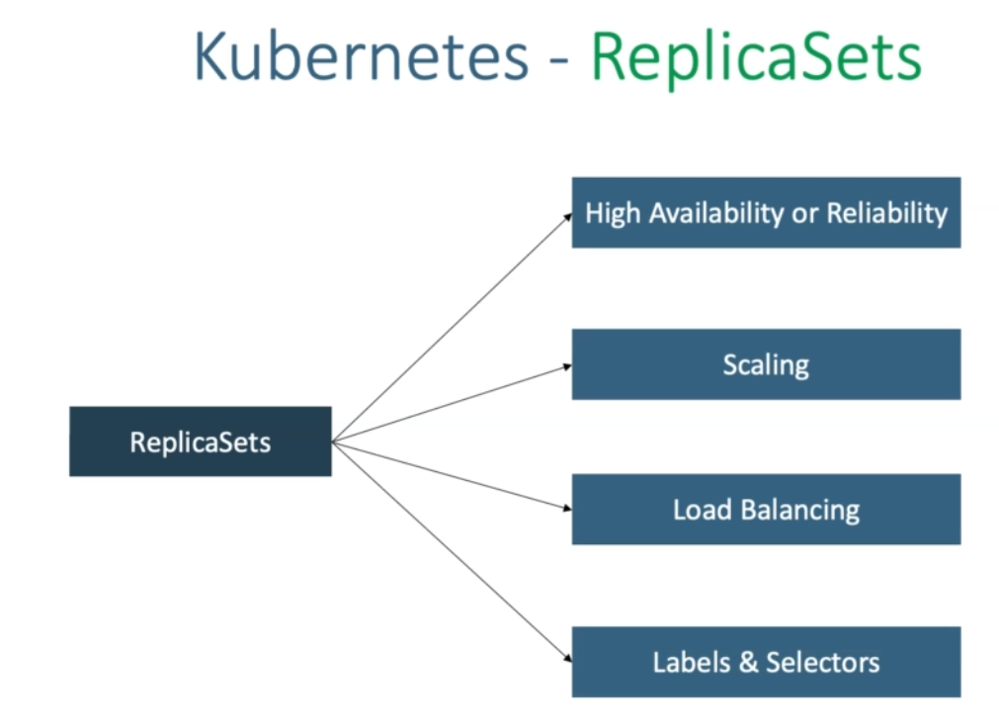

Slide 28
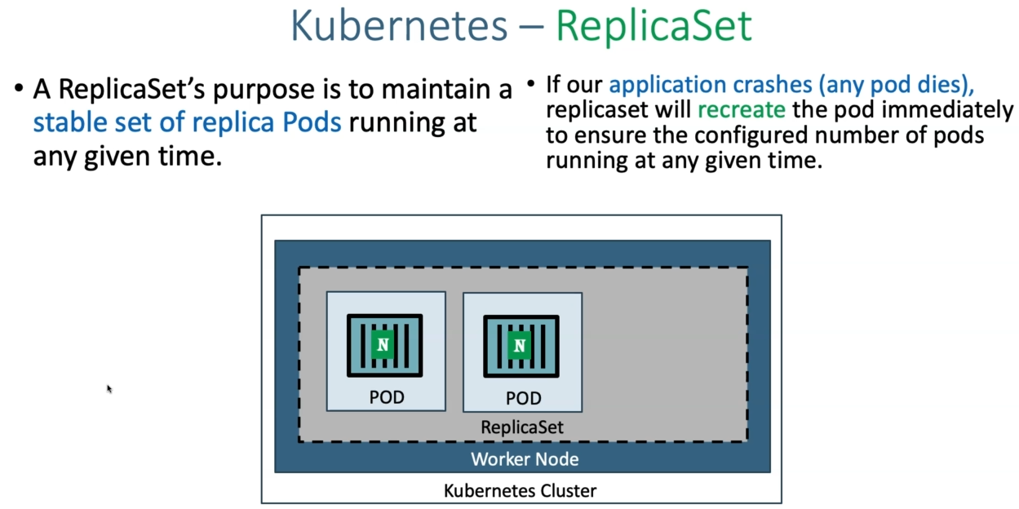
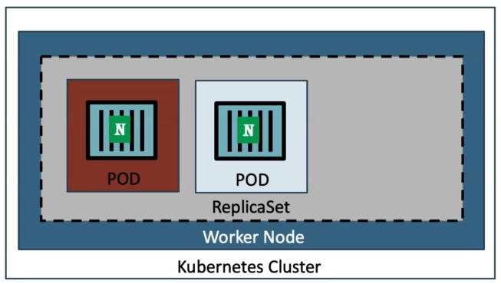
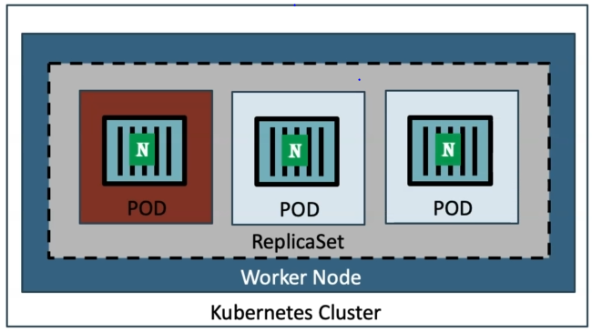

Slide 29
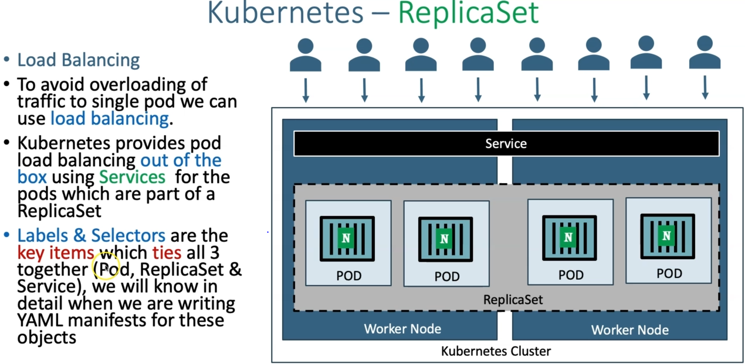
Replicaset contains 2. then 2 pods in one worker node and 2 in other. To access application hosted on this pods and then allow the effective load balncing we have the services in middle. Services will distributed the traffic to this respective replicaset and pods present inside that. In combination with replicaset and services we Can achive effective load balancing in k8s.

Slide 30
Create ReplicaSet
Create ReplicaSet
kubectl create -f replicaset-demo.yml
List ReplicaSets
Get list of ReplicaSets
kubectl get replicaset
kubectl get rs
Describe ReplicaSet
Describe the newly created ReplicaSet
kubectl describe rs/<replicaset-name>
kubectl describe rs/my-helloworld-rs
[or]
kubectl describe rs my-helloworld-rs
replicaset-demo.yml
apiVersion: apps/v1
kind: ReplicaSet
metadata:
name: my-helloworld-rs
labels:
app: my-helloworld
spec:
replicas: 3
selector:
matchLabels:
app: my-helloworld
template:
metadata:
labels:
app: my-helloworld
spec:
containers:
- name: my-helloworld-app
image: stacksimplify/kube-helloworld:1.0.0

Slide 31
Step-03: Expose ReplicaSet as a Service
Expose ReplicaSet with a service (Load Balancer Service) to access the application externally (from internet)
# Expose ReplicaSet as a Service
kubectl expose rs <ReplicaSet-Name> --type=LoadBalancer --port=80 --target-port=8080 --name=<Service-Name-To-Be-Created>
kubectl expose rs my-helloworld-rs --type=LoadBalancer --port=80 --target-port=8080 --name=my-helloworld-rs-service
# Get Service Info
kubectl get service
kubectl get svc
Access the Application using External or Public IP
http://<External-IP-from-get-service-output>/hello

Slide 32
Step-04: Test Replicaset Reliability or High Availability
Test how the high availability or reliability concept is achieved automatically in Kubernetes.
Whenever a POD is accidentally terminated due to some application issue, ReplicaSet should auto-create that Pod to maintain desired number of Replicas configured to achive High Availability.
# To get Pod Name
kubectl get pods
# Delete the Pod
kubectl delete pod <Pod-Name>
# Verify the new pod got created automatically
kubectl get pods (Verify Age and name of new pod)
Step-05: Test ReplicaSet Scalability feature
Test how scalability is going to seamless & quick
Update the replicas field in replicaset-demo.yml from 3 to 6.
# Before change
spec:
replicas: 3
# After change
spec:
replicas: 6
Update the ReplicaSet
# Apply latest changes to ReplicaSet
kubectl replace -f replicaset-demo.yml
# Verify if new pods got created
kubectl get pods -o wide

Slide 33
Step-06: Delete ReplicaSet & Service
Delete ReplicaSet
# Delete ReplicaSet
kubectl delete rs <ReplicaSet-Name>
# Sample Commands
kubectl delete rs/my-helloworld-rs
[or]
kubectl delete rs my-helloworld-rs
# Verify if ReplicaSet got deleted
kubectl get rs
Delete Service created for ReplicaSet
# Delete Service
kubectl delete svc <service-name>
# Sample Commands
kubectl delete svc my-helloworld-rs-service
[or]
kubectl delete svc/my-helloworld-rs-service
# Verify if Service got deleted
kubectl get svc

Slide 34
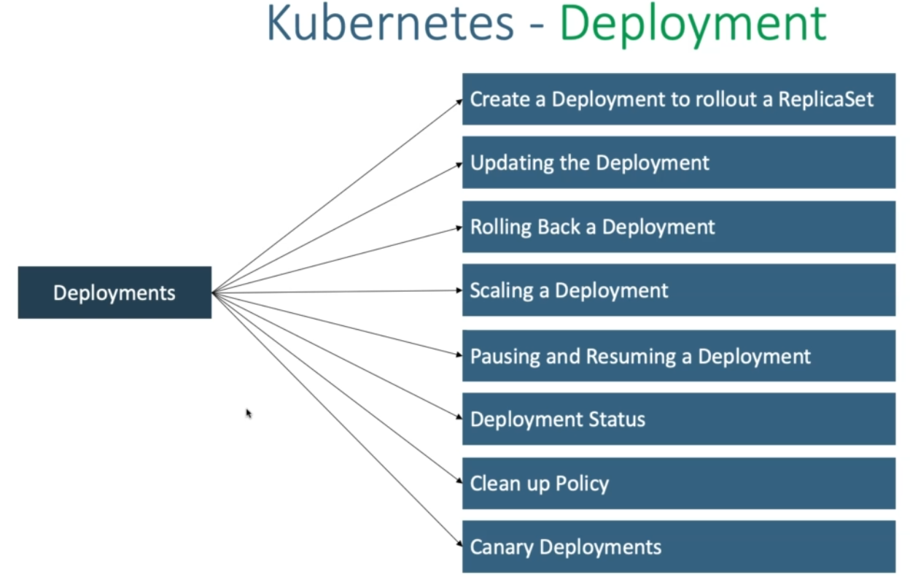

Slide 35
Create a deployment to rollout a replicaset: bydefault, when ever we created a deployent a replicaaset is rolled out.
Updating the deployment: we can chage our application version or update our application version and it is will recorded
Rolling back a deployment: We can easily rolle back to older versions because it maintains the versions. We can updaten from v1 to v2 to v3 and again go back to v2. coz it will maintaine the versions and version history.
Scale a deployment: how we done scale in replica sets in the same way we can scale deployments.
Pausing and Resuming a Deploymewnt: We change anything in deployment immediately it will apply to the pods. So, if you want to make multiple changes then you really don’t want the pods to be recreated or terminated for every change. Here we can pause the deployment and resume the deployments to that all those changes applied to your deployment at a time.
Deployment status: We can get the deployment status.
Clean up policy: When ever we do the updation of our deployment it maintains the rolleout version history by default. It maintains last 10 versions of our application.
Canary deployment:

Slide 36
Step-02: Create Deployment
Create Deployment to rollout a ReplicaSet
Verify Deployment, ReplicaSet & Pods
Docker Image Location: https://hub.docker.com/repository/docker/stacksimplify/kubenginx
# Create Deployment
kubectl create deployment <Deplyment-Name> --image=<Container-Image>
kubectl create deployment my-first-deployment --image=stacksimplify/kubenginx:1.0.0
# Verify Deployment
kubectl get deployments
kubectl get deploy
# Describe Deployment
kubectl describe deployment <deployment-name>
kubectl describe deployment my-first-deployment
# Verify ReplicaSet
kubectl get rs
# Verify Pod
kubectl get po

Slide 37
Step-03: Scaling a Deployment
Scale the deployment to increase the number of replicas (pods)
# Scale Up the Deployment
kubectl scale --replicas=10 deployment/<Deployment-Name>
kubectl scale --replicas=10 deployment/my-first-deployment
# Verify Deployment
kubectl get deploy
# Verify ReplicaSet
kubectl get rs
# Verify Pods
kubectl get po
# Scale Down the Deployment
kubectl scale --replicas=2 deployment/my-first-deployment
kubectl get deploy

Slide 38
Step-04: Expose Deployment as a Service
Expose Deployment with a service (LoadBalancer Service) to access the application externally (from internet)
# Expose Deployment as a Service
kubectl expose deployment <Deployment-Name> --type=LoadBalancer --port=80 --target-port=80 --name=<Service-Name-To-Be-Created>
kubectl expose deployment my-first-deployment --type=LoadBalancer --port=80 --target-port=80 --name=my-first-deployment-service
# Get Service Info
kubectl get svc

Slide 39
Kubernetes - Update Deployments
Step-00: Introduction
We can update deployments using two options
Set Image
Edit Deployment
Step-01: Updating Application version V1 to V2 using "Set Image" Option
Update Deployment
Observation: Please Check the container name in spec.container.name yaml output and make a note of it and replace in kubectl set image command
# Get Container Name from current deployment
kubectl get deployment my-first-deployment -o yaml
# Update Deployment - SHOULD WORK NOW
kubectl set image deployment/<Deployment-Name> <Container-Name>=<Container-Image> --record=true
kubectl set image deployment/my-first-deployment kubenginx=stacksimplify/kubenginx:2.0.0 --record=true

Slide 40
Step-02: Update the Application from V2 to V3 using "Edit Deployment" Option
# Edit Deployment
kubectl edit deployment/<Deployment-Name> --record=true
kubectl edit deployment/my-first-deployment --record=true
# Change From 2.0.0
spec:
containers:
- image: stacksimplify/kubenginx:2.0.0
# Change To 3.0.0
spec:
containers:
- image: stacksimplify/kubenginx:3.0.0

Slide 41
Verify Rollout Status (Deployment Status)
Observation: By default, rollout happens in a rolling update model, so no downtime.
# Verify Rollout Status
kubectl rollout status deployment/my-first-deployment
# Verify Deployment
kubectl get deploy
Describe Deployment
Observation:
Verify the Events and understand that Kubernetes by default do "Rolling Update" for new application releases.
With that said, we will not have downtime for our application.
# Descibe Deployment
kubectl describe deployment my-first-deployment

Slide 42
Verify ReplicaSet
Observation: New ReplicaSet will be created for new version
# Verify ReplicaSet
kubectl get rs
Verify Pods
Observation: Pod template hash label of new replicaset should be present for PODs letting us know these pods belong to new ReplicaSet.
# List Pods
kubectl get po
Verify Rollout History of a Deployment
Observation: We have the rollout history, so we can switch back to older revisions using revision history available to us.
# Check the Rollout History of a Deployment
kubectl rollout history deployment/<Deployment-Name>
kubectl rollout history deployment/my-first-deployment
Access the Application using Public IP
We should see Application Version:V2 whenever we access the application in browser
# Get Load Balancer IP
kubectl get svc
# Application URL
http://<External-IP-from-get-service-output>

Slide 43
Rollback Deployment
Step-00: Introduction
We can rollback a deployment in two ways.
Previous Version
Specific Version
Step-01: Rollback a Deployment to previous version
Check the Rollout History of a Deployment
# List Deployment Rollout History
kubectl rollout history deployment/<Deployment-Name>
kubectl rollout history deployment/my-first-deployment
Verify changes in each revision
Observation: Review the "Annotations" and "Image" tags for clear understanding about changes.
# List Deployment History with revision information
kubectl rollout history deployment/my-first-deployment --revision=1
kubectl rollout history deployment/my-first-deployment --revision=2
kubectl rollout history deployment/my-first-deployment --revision=3

Slide 44
1. Rollback to previous version:
Observation: If we rollback, it will go back to revision-2 and its number increases to revision-4
# Undo Deployment
kubectl rollout undo deployment/my-first-deployment
2. Rollback to specific revision
Rollback to specific revision
# Rollback Deployment to Specific Revision
kubectl rollout undo deployment/my-first-deployment --to-revision=3
3 Rolling Restarts of Application
Rolling restarts will kill the existing pods and recreate new pods in a rolling fashion.
# Rolling Restarts
kubectl rollout restart deployment/<Deployment-Name>
kubectl rollout restart deployment/my-first-deployment
# Get list of Pods
kubectl get po

Slide 45
# List Deployment Rollout History
kubectl rollout history deployment/<Deployment-Name>
kubectl rollout history deployment/my-first-deployment
#Verify Deployment, Pods, ReplicaSets
kubectl get deploy
kubectl get rs
kubectl get po
kubectl describe deploy my-first-deployment
#Access the Application using Public IP
We should see Application Version:V2 whenever we access the application in browser
# Get Load Balancer IP
kubectl get svc
# Application URL
http://<External-IP-from-get-service-output>
http://<Load-Balancer-IP>

Slide 46
Pause & Resume Deployments
Step-00: Introduction
Why do we need Pausing & Resuming Deployments?
If we want to make multiple changes to our Deployment, we can pause the deployment make all changes and resume it.
We are going to update our Application Version from V3 to V4 as part of learning "Pause and Resume Deployments“
Step-01: Pausing & Resuming Deployments
# Check the Rollout History of a Deployment
kubectl rollout history deployment/my-first-deployment
Observation: Make a note of last version number
# Get list of ReplicaSets
kubectl get rs
Observation: Make a note of number of replicaSets present.
# Access the Application
http://<External-IP-from-get-service-output>
Observation: Make a note of application version

Slide 47
Pause Deployment and Two Changes
# Pause the Deployment
kubectl rollout pause deployment/<Deployment-Name>
kubectl rollout pause deployment/my-first-deployment
# Update Deployment - Application Version from V3 to V4
kubectl set image deployment/my-first-deployment kubenginx=stacksimplify/kubenginx:4.0.0 --record=true
# Check the Rollout History of a Deployment
kubectl rollout history deployment/my-first-deployment
Observation: No new rollout should start, we should see same number of versions as we check earlier with last version number matches which we have noted earlier.
# Get list of ReplicaSets
kubectl get rs
Observation: No new replicaSet created. We should have same number of replicaSets as earlier when we took note.
# Make one more change: set limits to our container
kubectl set resources deployment/my-first-deployment -c=kubenginx --limits=cpu=20m,memory=30Mi

Slide 48
Resume Deployment
# Resume the Deployment
kubectl rollout resume deployment/my-first-deployment
# Check the Rollout History of a Deployment
kubectl rollout history deployment/my-first-deployment
Observation: You should see a new version got created
# Get list of ReplicaSets
kubectl get rs
Observation: You should see new ReplicaSet.
# Access the Application
http://<External-IP-from-get-service-output>
Observation: You should see Application V4 version
Step-02: Clean-Up
# Delete Deployment
kubectl delete deployment my-first-deployment
# Delete Service
kubectl delete svc my-first-deployment-service
# Get Load Balancer IP
kubectl get svc
Access Application
# Get all Objects from Kubernetes default namespace
kubectl get all

Slide 49
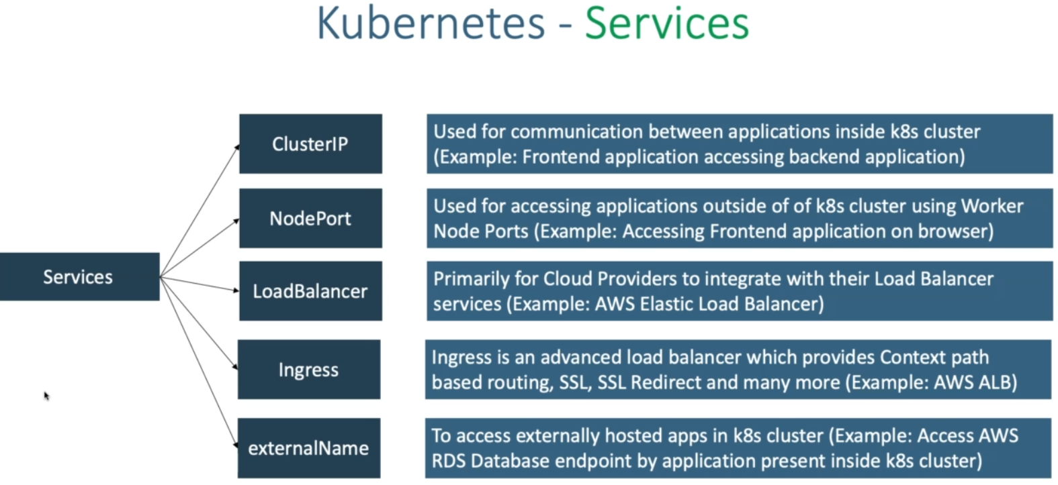

Slide 50
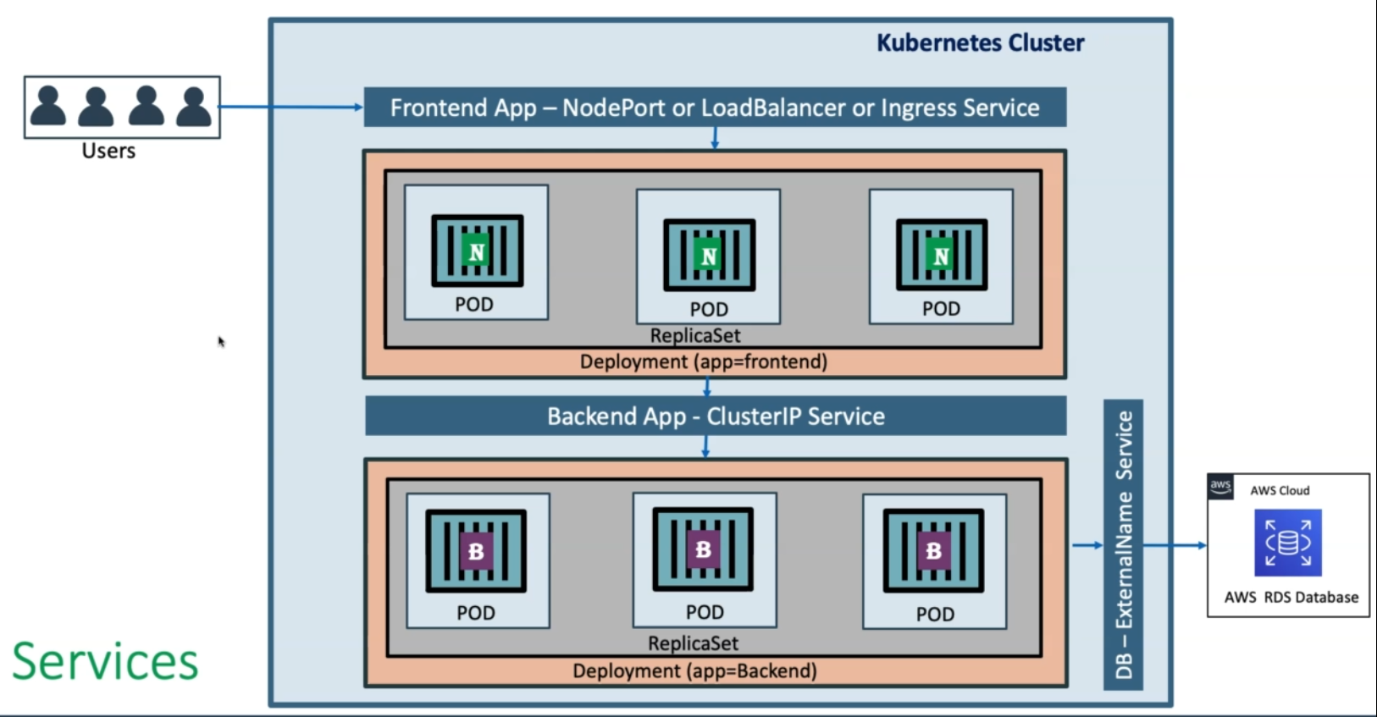

Slide 51
Kubernetes - Services
Step-01: Introduction to Services
Service Types:
ClusterIp
NodePort
LoadBalancer
ExternalName
Ingress
We are going to look in to ClusterIP and LoadBalancer Service in this section with a detailed example.
LoadBalancer Type is primarily for cloud providers and it will differ cloud to cloud, so we will do it accordingly (per cloud basis)
ExternalName doesn't have Imperative commands and we need to write YAML definition for the same, so we will look in to it as and when it is required in our course.

Slide 52
Step-02: ClusterIP Service - Backend Application Setup
Create a deployment for Backend Application (Spring Boot REST Application)
Create a ClusterIP service for load balancing backend application.
# Create Deployment for Backend Rest App
kubectl create deployment my-backend-rest-app --image=stacksimplify/kube-helloworld:1.0.0
kubectl get deploy
# Create ClusterIp Service for Backend Rest App
kubectl expose deployment my-backend-rest-app --port=8080 --target-port=8080 --name=my-backend-service
kubectl get svc
Observation: We don't need to specify "--type=ClusterIp" because default setting is to create ClusterIp Service.
Important Note: If backend application port (Container Port: 8080) and Service Port (8080) are same we don't need to use --target-port=8080 but for avoiding the confusion i have added it. Same case applies to frontend application and service.
Backend HelloWorld Application Source kube-helloworld

Slide 53
Step-03: LoadBalancer Service - Frontend Application Setup
We have implemented LoadBalancer Service multiple times so far (in pods, replicasets and deployments), even then we are going to implement one more time to get a full architectural view in relation with ClusterIp service.
Create a deployment for Frontend Application (Nginx acting as Reverse Proxy)
Create a LoadBalancer service for load balancing frontend application.
Important Note: In Nginx reverse proxy, ensure backend service name my-backend-service is updated when you are building the frontend container. We already built it and put ready for this demo (stacksimplify/kube-frontend-nginx:1.0.0)
Nginx Conf File
server {
listen 80;
server_name localhost;
location / {
# Update your backend application Kubernetes Cluster-IP Service name and port below
# proxy_pass http://<Backend-ClusterIp-Service-Name>:<Port>;
proxy_pass http://my-backend-service:8080;
}
error_page 500 502 503 504 /50x.html;
location = /50x.html {
root /usr/share/nginx/html;
}
}

Slide 54
Docker Image Location: https://hub.docker.com/repository/docker/stacksimplify/kube-frontend-nginx
Frontend Nginx Reverse Proxy Application Source kube-frontend-nginx
# Create Deployment for Frontend Nginx Proxy
kubectl create deployment my-frontend-nginx-app --image=stacksimplify/kube-frontend-nginx:1.0.0
kubectl get deploy
# Create LoadBalancer Service for Frontend Nginx Proxy
kubectl expose deployment my-frontend-nginx-app --type=LoadBalancer --port=80 --target-port=80 --name=my-frontend-service
kubectl get svc
# Get Load Balancer IP
kubectl get svc
http://<External-IP-from-get-service-output>/hello
# Scale backend with 10 replicas
kubectl scale --replicas=10 deployment/my-backend-rest-app
# Test again to view the backend service Load Balancing
http://<External-IP-from-get-service-output>/hello

Slide 55
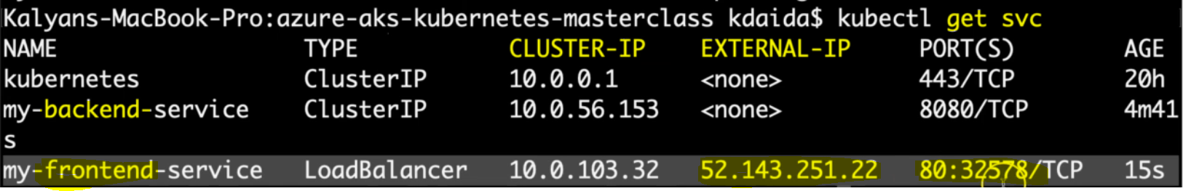
We don't need to specify "--type=ClusterIp" because default setting is to create ClusterIp Service.
If mention –type= LoadBalancer then it will create a External-IP. By using this we can access our front end app from browser.
we didn’t mentioned –type= LoadBalancer. If we want to access the application from out side then use <clusterIP:NodePort>.

Slide 56
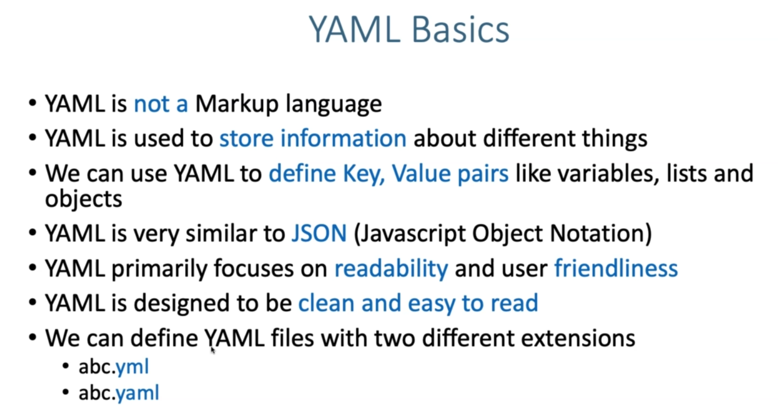

Slide 57
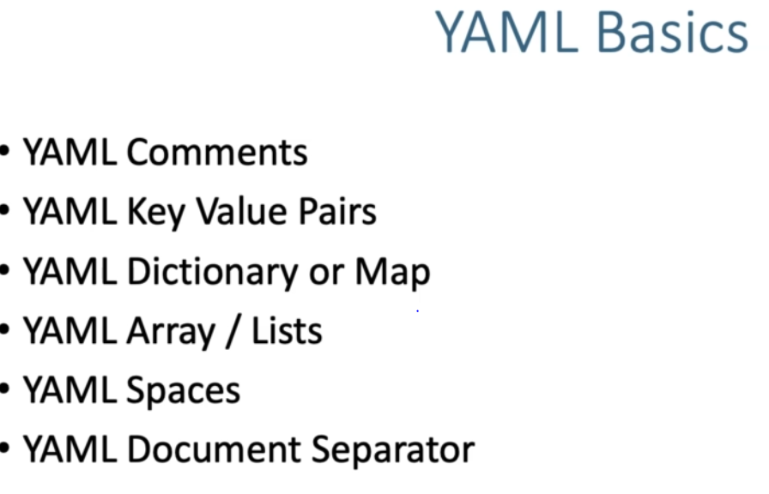

Slide 58
YAML Basics
Step-01: Comments & Key Value Pairs
Space after colon is mandatory to differentiate key and value
# Defining simple key value pairs
name: kalyan
age: 23
city: Hyderabad
Step-02: Dictionary / Map
Set of properties grouped together after an item
Equal amount of blank space required for all the items under a dictionary
person:
name: kalyan
age: 23
city: Hyderabad
Step-03: Array / Lists
Dash indicates an element of an array
person: # Dictionary
name: kalyan
age: 23
city: Hyderabad
hobbies: # List
- cycling
- cookines
hobbies: [cycling, cooking] # List with a differnt notation

Slide 59
Step-04: Multiple Lists
Dash indicates an element of an array
person: # Dictionary
name: kalyan
age: 23
city: Hyderabad
hobbies: # List
- cycling
- cooking
hobbies: [cycling, cooking] # List with a differnt notation
friends: #
- name: friend1
age: 22
- name: friend2
age: 25
Step-05: Sample Pod Tempalte for Reference
apiVersion: v1 # String
kind: Pod # String
metadata: # Dictionary
name: myapp-pod
labels: # Dictionary
app: myapp
spec:
containers: # List
- name: myapp
image: stacksimplify/kubenginx:1.0.0
ports:
- containerPort: 80
protocol: "TCP"
- containerPort: 81
protocol: "TCP"

Slide 60
# Simple Key value Pairs
person: # Dictionary
name: kalyan
age: 23
city: Hyderabd
hobbies: # List
- cooking
- cycling
friends: # Multiple lists
- name: friend1
age: 23
- name: friend2
age: 22
--- # YAML Document Separator
apiVersion: v1 # String
kind: Pod # String
metadata: # Dictionary
name: myapp-pod
labels: # Dictionary
app: myapp
tier: frontend
spec:
containers: # List
- name: myapp
image: stacksimplify/kubenginx:1.0.0
ports: # List
- containerPort: 80
protocol: "TCP"
- containerPort: 81
protocol: "TCP"
01-kube-base-definition.yml
apiVersion:
kind:
metadata:
name:
labels:
namespace:
spec:
# Types of Kubernetes Objects
# Pod, ReplicaSet, Deployment, Service and many more
# apiVersion: version of k8s objects
# kind: k8s objects
# metadata: define name and labels for k8s objects
# spec: specification or real definition for k8s objects

Slide 61
PODs with YAML
Step-01: Kubernetes YAML Top level Objects
Discuss about the k8s YAML top level objects
01-kube-base-definition.yml
apiVersion:
kind:
metadata:
spec:
Step-02: Create Simple Pod Definition using YAML
We are going to create a very basic pod definition
02-pod-definition.yml
apiVersion: v1 # String
kind: Pod # String
metadata: # Dictionary
name: myapp-pod
labels: # Dictionary
app: myapp
spec:
containers: # List
- name: myapp
image: stacksimplify/kubenginx:1.0.0
ports:
- containerPort: 80
Create Pod
# Create Pod
kubectl create -f 02-pod-definition.yml
[or]
kubectl apply -f 02-pod-definition.yml
# List Pods
kubectl get pods

Slide 62
Step-03: Create a LoadBalancer Service
03-pod-LoadBalancer-service.yml
apiVersion: v1
kind: Service
metadata:
name: myapp-pod-loadbalancer-service # Name of the Service
spec:
type: LoadBalancer # ClusterIp, # NodePort
selector:
# Loadbalance traffic across Pods matching this label selector
app: myapp
# Accept traffic sent to port 80
ports:
- name: http
port: 80 # Service Port
targetPort: 80 # Container Port
Create LoadBalancer Service for Pod
# Create Service
kubectl apply -f 03-pod-LoadBalancer-service.yml
# List Service
kubectl get svc
# Access Application
http://<Load-Balancer-Service-IP>
Note: Pods can be selected by using the label define inside the selectors of service manifest. Selector is nothing but to which pod you want to send the incoming traffic to respective service. The selector label name should match which pod label or deplotment label.

Slide 63
ReplicaSets with YAML
replicaset-definition.yml
apiVersion: apps/v1
kind: ReplicaSet
metadata:
name: myapp2-rs # (name of the Replicaset)
spec:
replicas: 3 # 3 Pods should exist at all times.
selector: # Pods label should be defined in ReplicaSet label selector
matchLabels:
app: myapp2
template:
metadata:
name: myapp2-pod #(name of the pod)
labels:
app: myapp2 # Atleast 1 Pod label should match with ReplicaSet Label Selector
spec:
containers:
- name: myapp2
image: stacksimplify/kubenginx:2.0.0
ports:
- containerPort: 80

Slide 64
Step-02: Create ReplicaSet
Create ReplicaSet with 3 Replicas
# Create ReplicaSet
kubectl apply -f 02-replicaset-definition.yml
# List Replicasets
kubectl get rs
Delete a pod
ReplicaSet immediately creates the pod.
# List Pods
kubectl get pods
# Delete Pod
kubectl delete pod <Pod-Name>

Slide 65
Step-03: Create LoadBalancer Service for ReplicaSet
apiVersion: v1
kind: Service
metadata:
name: replicaset-loadbalancer-service
spec:
type: LoadBalancer
selector:
app: myapp2
ports:
- name: http
port: 80
targetPort: 80
Create LoadBalancer Service for ReplicaSet & Test
# Create LoadBalancer Service
kubectl apply -f 03-replicaset-LoadBalancer-servie.yml
# List LoadBalancer Service
kubectl get svc
# Access Application
http://<Load-Balancer-Service-IP>

Slide 66
Deployments with YAML
Step-01: Copy templates from ReplicaSet
Copy templates from ReplicaSet and change the kind: Deployment
Update Container Image version to 3.0.0
Change all names to Deployment
Change all labels and selectors to myapp3
# Create Deployment
kubectl apply -f 02-deployment-definition.yml
kubectl get deploy
kubectl get rs
kubectl get po
# Create LoadBalancer Service
kubectl apply -f 03-deployment-LoadBalancer-service.yml
# List Service
kubectl get svc
# Get Public IP
kubectl get nodes -o wide
# Access Application
http://<Load-Balancer-Service-IP>

Slide 67
02-deployment-definition.yml
apiVersion: apps/v1
kind: Deployment
metadata: #Dictionary
name: myapp3-deployment
spec: # Dictionary
replicas: 3
selector:
matchLabels:
app: myapp3
template:
metadata: # Dictionary
name: myapp3-pod
labels: # Dictionary
app: myapp3 # Key value paids
spec:
containers: # List
- name: myapp3-container
image: stacksimplify/kubenginx:3.0.0
ports:
- containerPort: 80
03-deployment-LoadBalancer-servie.yml
apiVersion: v1
kind: Service
metadata:
name: deployment-loadbalancer-service
spec:
type: LoadBalancer # ClusterIp, # NodePort
selector:
app: myapp3
ports:
- name: http
port: 80 # Service Port
targetPort: 80 # Container Port

Slide 68
Services with YAML
Step-01: Introduction to Services
We are going to look in to below two services in detail with a frotnend and backend example
LoadBalancer Service
ClusterIP Service

Slide 69
#frontend-deployment.yml
apiVersion: apps/v1
kind: Deployment
metadata:
name: frontend-nginxapp
labels:
app: frontend-nginxapp
tier: frontend
spec:
replicas: 3
selector:
matchLabels:
app: frontend-nginxapp
template:
metadata:
labels:
app: frontend-nginxapp
tier: frontend
spec:
containers:
- name: frontend-nginxapp
image: stacksimplify/kube-frontend-nginx:1.0.0
ports:
- containerPort: 80
#frontend-LoadBalancer-service.yml
apiVersion: v1
kind: Service
metadata:
name: frontend-nginxapp-loadbalancer-service
labels:
app: frontend-nginxapp
tier: frontend
spec:
type: LoadBalancer # ClusterIp, # NodePort
selector:
app: frontend-nginxapp
ports:
- name: http
port: 80 # Service Port
targetPort: 80 # Container Port

Slide 70
# backend-deployment.yml
apiVersion: apps/v1
kind: Deployment
metadata:
name: backend-restapp
labels:
app: backend-restapp
tier: backend
spec:
replicas: 3
selector:
matchLabels:
app: backend-restapp
template:
metadata:
labels:
app: backend-restapp
tier: backend
spec:
containers:
- name: backend-restapp
image: stacksimplify/kube-helloworld:1.0.0
ports:
- containerPort: 8080
#backend-clusterip-service.yml
apiVersion: v1
kind: Service
metadata:
name: my-backend-service ## VERY VERY IMPORTANT - NGINX PROXYPASS needs this name
labels:
app: backend-restapp
tier: backend
spec:
#type: ClusterIP is a default service in k8s
selector:
app: backend-restapp
ports:
- name: http
port: 8080 # ClusterIP Service Port
targetPort: 8080 # Container Port

Slide 71
Step-02: Create Backend Deployment & Cluster IP Service
Write the Deployment template for backend REST application.
Write the Cluster IP service template for backend REST application.
Important Notes:
Name of Cluster IP service should be name: my-backend-service because same is configured in frontend nginx reverse proxy default.conf.
Test with different name and understand the issue we face
We have also discussed about in our section 03-04-Services-with-kubectl
kubectl get all
kubectl apply -f 01-backend-deployment.yml -f 02-backend-clusterip-service.yml
kubectl get all
Step-03: Create Frontend Deployment & LoadBalancer Service
Write the Deployment template for frontend Nginx Application
Write the LoadBalancer service template for frontend Nginx Application
kubectl get all
kubectl apply -f 03-frontend-deployment.yml -f 04-frontend-LoadBalancer-service.yml
kubectl get all

Slide 72
Access REST Application
# Get Service IP
kubectl get svc
# Access REST Application
http://<Load-Balancer-Service-IP>/hello
Step-04: Delete & Recreate Objects using kubectl apply
Delete Objects (file by file)
kubectl delete -f 01-backend-deployment.yml -f 02-backend-clusterip-service.yml -f 03-frontend-deployment.yml -f 04-frontend-LoadBalancer-service.yml
kubectl get all
Recreate Objects using YAML files in a folder
kubectl apply -f kube-manifests/
kubectl get all
Delete Objects using YAML files in folder
kubectl delete -f kube-manifests/
kubectl get all

Slide 73
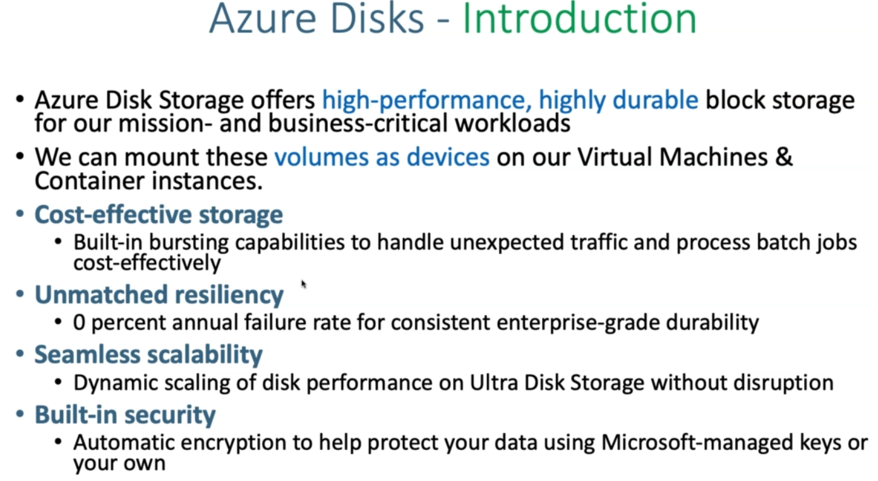

Slide 74
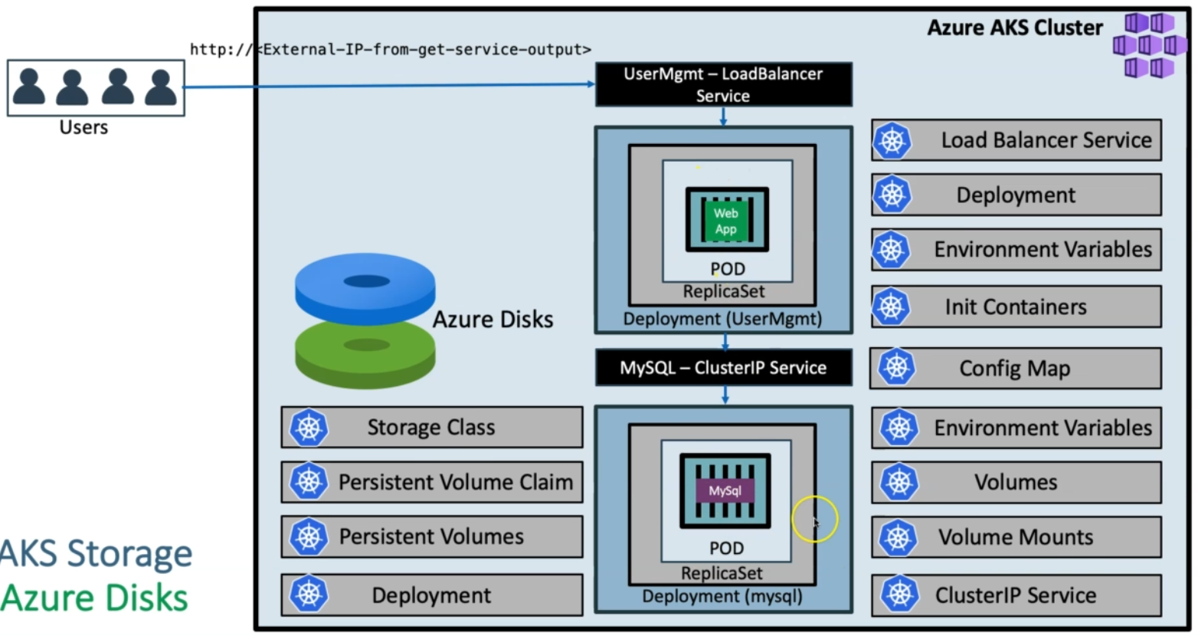

Slide 75
Why we are provisioning the custom storage class:
even the azure related workloads are deleted like persistent volume claim and everything gets deleted still the azure disk should be retained until and unless k8s cluster deleted.
azure-aks-kubernetes-masterclass/01-storage-class.yml at master · stacksimplify/azure-aks-kubernetes-masterclass · GitHub
01-storage-class.yml
apiVersion: storage.k8s.io/v1
kind: StorageClass
metadata:
name: managed-premium-retain-sc
provisioner: kubernetes.io/azure-disk
reclaimPolicy: Retain # Default is Delete, recommended is retain
volumeBindingMode: WaitForFirstConsumer # Default is Immediate, recommended is WaitForFirstConsumer
allowVolumeExpansion: true
parameters:
storageaccounttype: Premium_LRS # or we can use Standard_LRS
kind: managed # Default is shared (Other two are managed and dedicated)

Slide 76
# Note-1:
#volumeBindingMode: Immediate - This setting implies that the PersistentVolumecreation,
#followed with the storage medium (Azure Disk in this case) provisioning is triggered as
#soon as the PersistentVolumeClaim is created.
# Note-2:
# volumeBindingMode: WaitForFirstConsumer
#By default, the Immediate mode indicates that volume binding and dynamic provisioning
#occurs once the PersistentVolumeClaim is created. For storage backends that are
#topology-constrained and not globally accessible from all Nodes in the cluster,
#PersistentVolumes will be bound or provisioned without knowledge of the Pod's scheduling
#requirements. This may result in unschedulable Pods.
#A cluster administrator can address this issue by specifying the WaitForFirstConsumer
#mode which will delay the binding and provisioning of a PersistentVolume until a
#Pod using the PersistentVolumeClaim is created. PersistentVolumes will be selected or
#provisioned conforming to the topology that is specified by the Pod's scheduling
#constraints.

Slide 77
# Note-3:
#reclaimPolicy: Delete - With this setting, as soon as a PersistentVolumeClaim is deleted,
#it also triggers the removal of the corresponding PersistentVolume along with the
#Azure Disk.
#We will be surprised provided if we intended to retain that data as backup.
# reclaimPolicy: retain - Disk is retained even when PVC is deleted - Recommended Option
# Note-4:
# Both reclaimPolicy: Delete and volumeBindingMode: Immediate are default settings
##############################################################################
# Note-5:
# Additional Reference
# https://kubernetes.io/docs/concepts/storage/storage-classes/#azure-disk
# Managed: When managed used, that disk is persisted for the Lifecycle of the cluster.
# If we delete cluster, it will delete the disk

Slide 78
02-persistent-volume-claim.yml
apiVersion: v1
kind: PersistentVolumeClaim
metadata:
name: azure-managed-disk-pvc
spec:
accessModes:
- ReadWriteOnce
storageClassName: managed-premium-retain-sc
resources:
requests:
storage: 5Gi
# List Storage Classes
kubectl get sc
# List PVC
kubectl get pvc
# List PV
kubectl get pv
kubectl apply -f kube-manifests/01-storage-class.yml
kubectl apply -f kube-manifests/02-persistent-volume-claim.yml

Slide 79
ConfigMaps
A ConfigMap is an API object used to store non-confidential data in key-value pairs. Pods can consume ConfigMaps as environment variables, command-line arguments, or as configuration files in a volume. A ConfigMap allows you to decouple environment-specific configuration from your container images, so that your applications are easily portable.
#03-UserManagement-ConfigMap.yml
apiVersion: v1
kind: ConfigMap
metadata:
name: usermanagement-dbcreation-script
data:
mysql_usermgmt.sql: |-
DROP DATABASE IF EXISTS webappdb;
CREATE DATABASE webappdb;

Slide 80
spec:
containers:
- name: mysql
image: mysql:5.6
env:
- name: MYSQL_ROOT_PASSWORD
value: dbpassword11
ports:
- containerPort: 3306
name: mysql
volumeMounts:
- name: mysql-persistent-storage
mountPath: /var/lib/mysql
- name: usermanagement-dbcreation-script
mountPath: /docker-entrypoint-initdb.d
#https://hub.docker.com/_/mysql
#Refer Initializing a fresh instance
volumes:
- name: mysql-persistent-storage
persistentVolumeClaim:
claimName: azure-managed-disk-pvc
- name: usermanagement-dbcreation-script
configMap:
name: usermanagement-dbcreation-script
Create MySQL Deployment manifest
Environment Variables
Volumes
Volume Mounts
#04-mysql-deployment.yml
apiVersion: apps/v1
kind: Deployment
metadata:
name: mysql
spec:
replicas: 1
selector:
matchLabels:
app: mysql
strategy:
type: Recreate
template:
metadata:
labels:
app: mysql

Slide 81
Create MySQL ClusterIP Service manifest
At any point of time we are going to have only one mysql pod in this design so ClusterIP: None will use the Pod IP Address instead of creating or allocating a separate IP for MySQL Cluster IP service.
#05-mysql-clusterip-service.yml
apiVersion: v1
kind: Service
metadata:
name: mysql
spec:
selector:
app: mysql
ports:
- port: 3306
clusterIP: None # This means we are going to use Pod IP

Slide 82
1:Create MySQL Database with all above manifests
# Create MySQL Database
kubectl apply -f kube-manifests/
# List Storage Classes
kubectl get sc
# List PVC
kubectl get pvc
# List PV
kubectl get pv
# List pods
kubectl get pods
# List pods based on label name
kubectl get pods -l app=mysql
3:Verify usermgmt schema got created which we provided in ConfigMap
mysql> show schemas;
Step-05: Clean-Up
# Delete All
kubectl delete -f kube-manifests/
Step-06: Delete PV exclusively - It exists due to retain policy
# List PV
kubect get pv
# Delete PV exclusively
kubectl get pv
kubectl delete pv <PV-NAME>
# Delete Azure Disks
Go to All Services -> Disks -> Select and Delete the Disk
2:Connect to MYSQL Database
kubectl run -it --rm --image=mysql:5.6 --restart=Never mysql-client -- mysql -h mysql -pdbpassword11

Slide 83
Step-07: References & Storage Best Practices
We need to discuss references exclusively here.
https://docs.microsoft.com/en-us/azure/aks/concepts-storage
https://docs.microsoft.com/en-us/azure/aks/operator-best-practices-storage
https://docs.microsoft.com/en-us/azure/aks/azure-disks-dynamic-pv
https://kubernetes.io/docs/concepts/storage/persistent-volumes/
https://kubernetes.io/docs/concepts/storage/storage-classes/#azure-disk
https://kubernetes.io/docs/reference/generated/kubernetes-api/v1.18/#storageclass-v1-storage-k8s-io

Slide 84
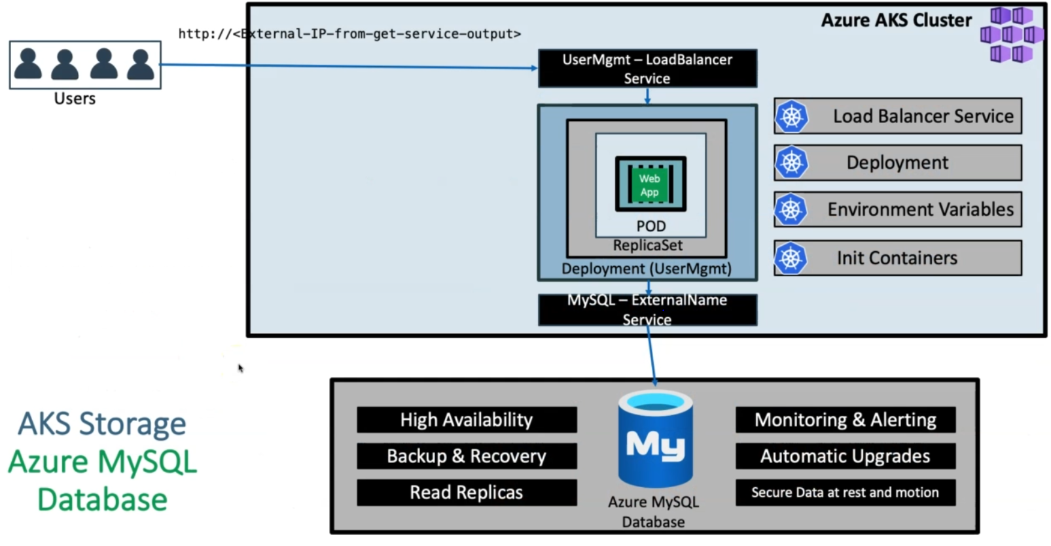

Slide 85
#01-MySQL-externalName-Service.yml
apiVersion: v1
kind: Service
metadata:
name: mysql
spec:
type: ExternalName
externalName: akswebappdb.mysql.database.azure.com
#server name if sql database

Slide 86
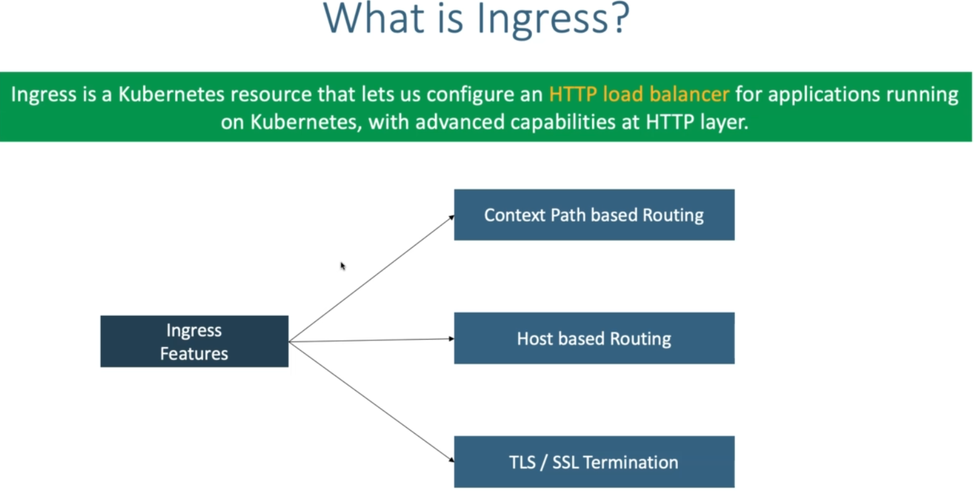

Slide 87
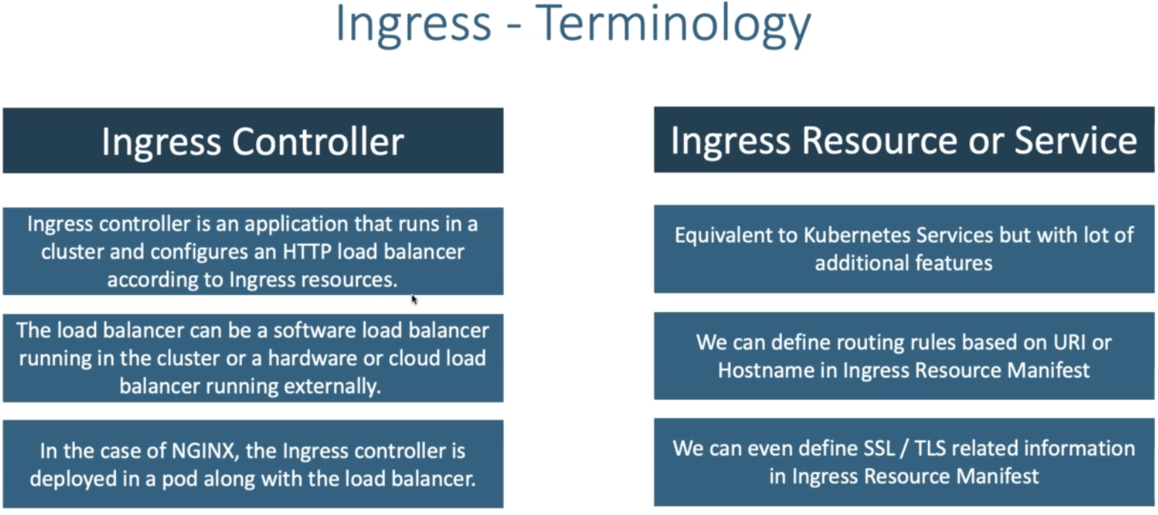

Slide 88
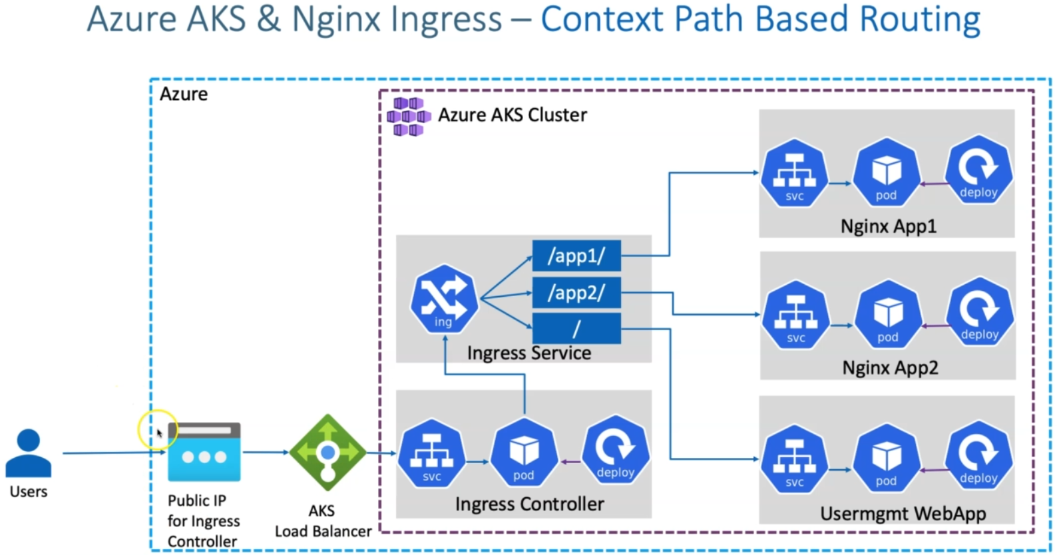

Slide 89
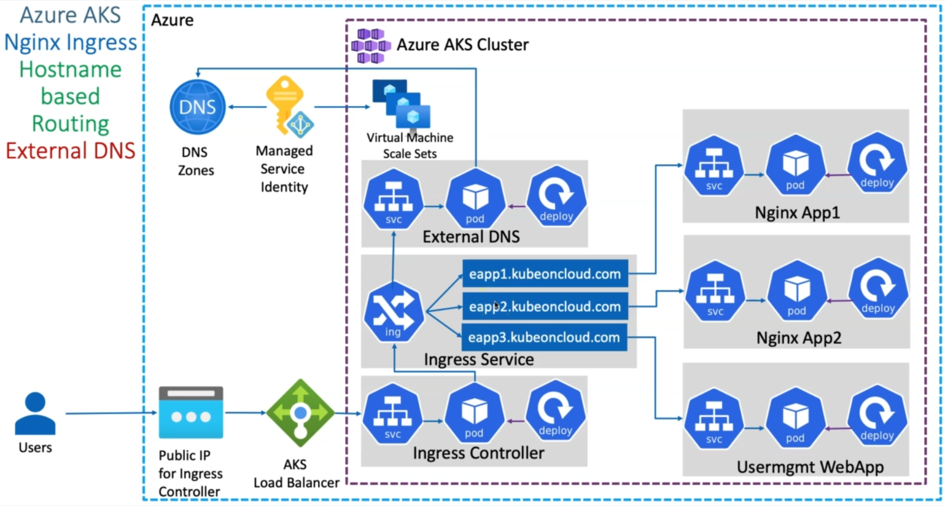

Slide 90
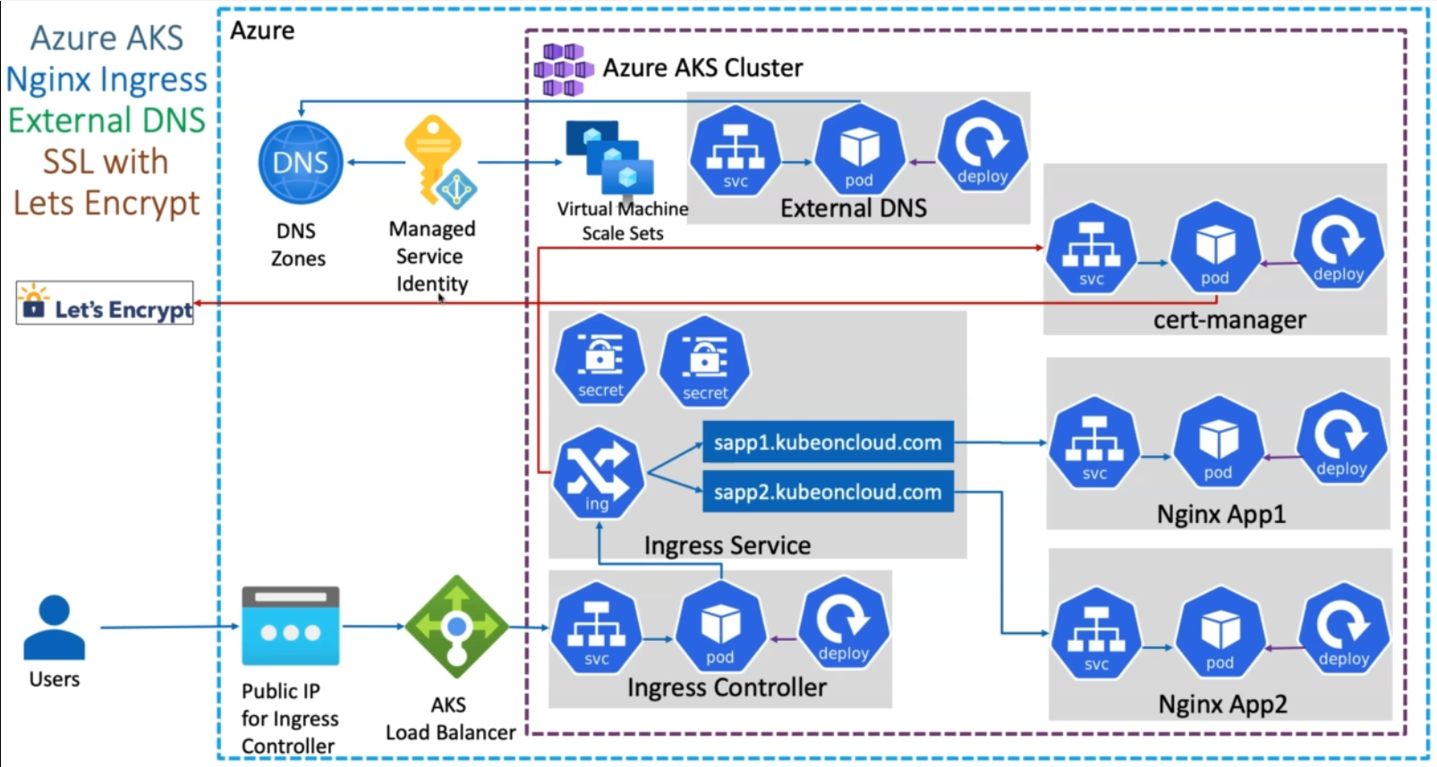

Slide 91
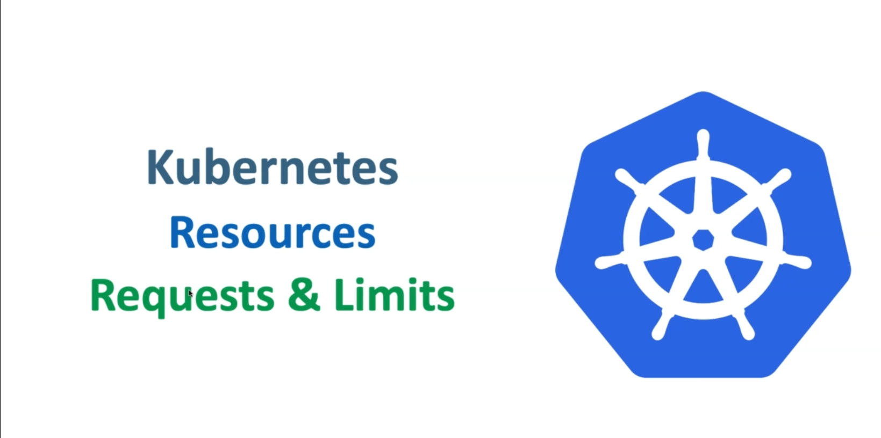

Slide 92
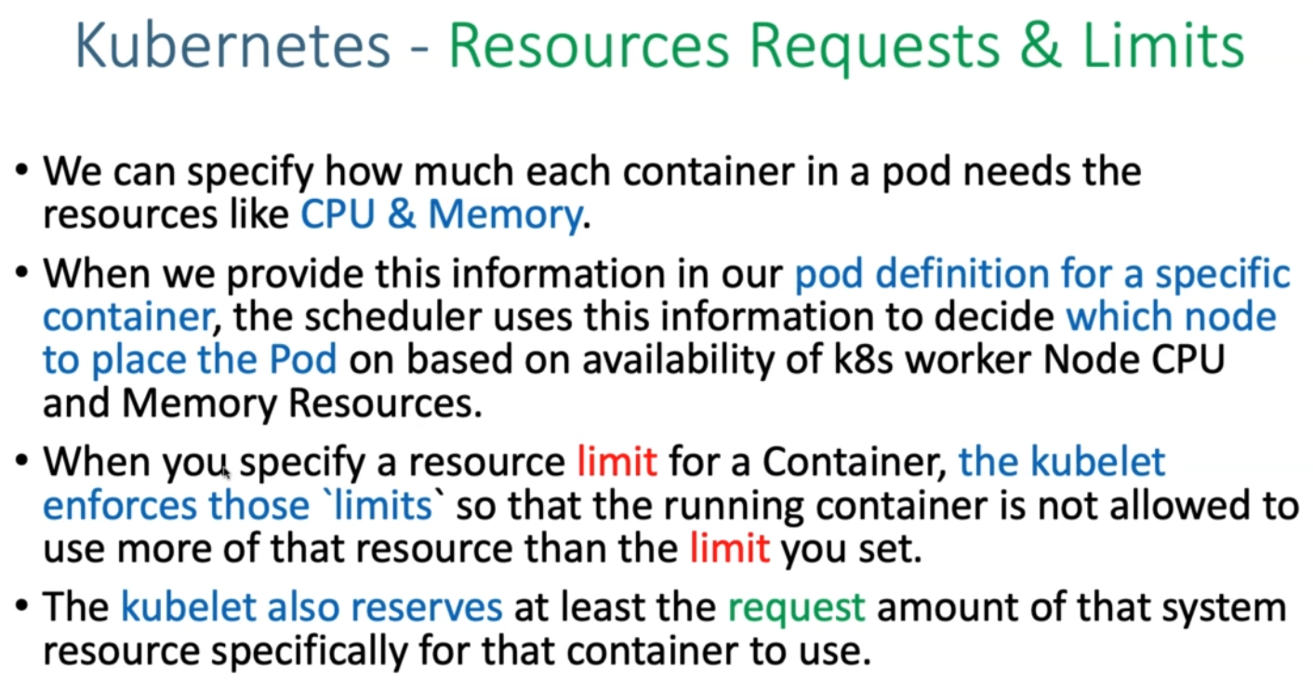

Slide 93
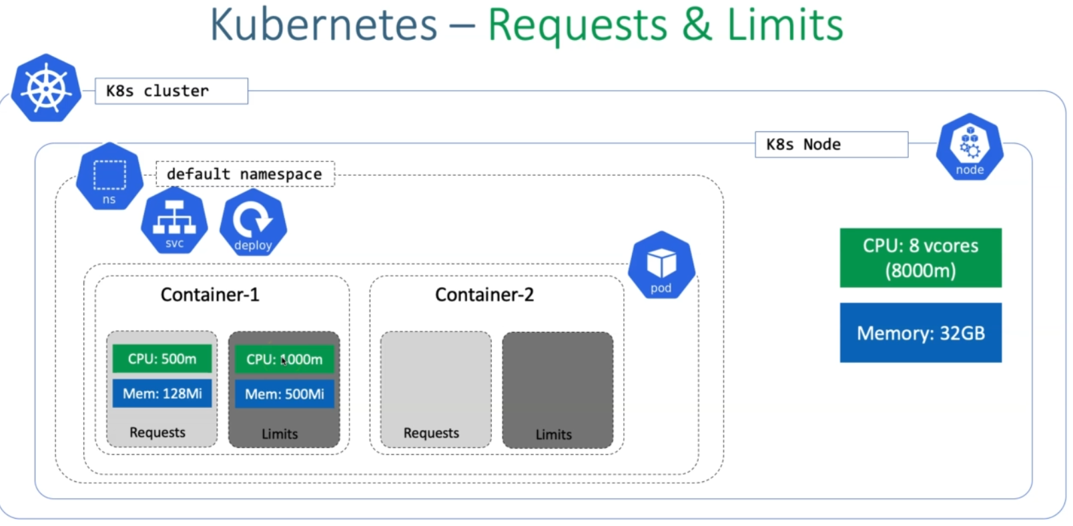

Slide 94
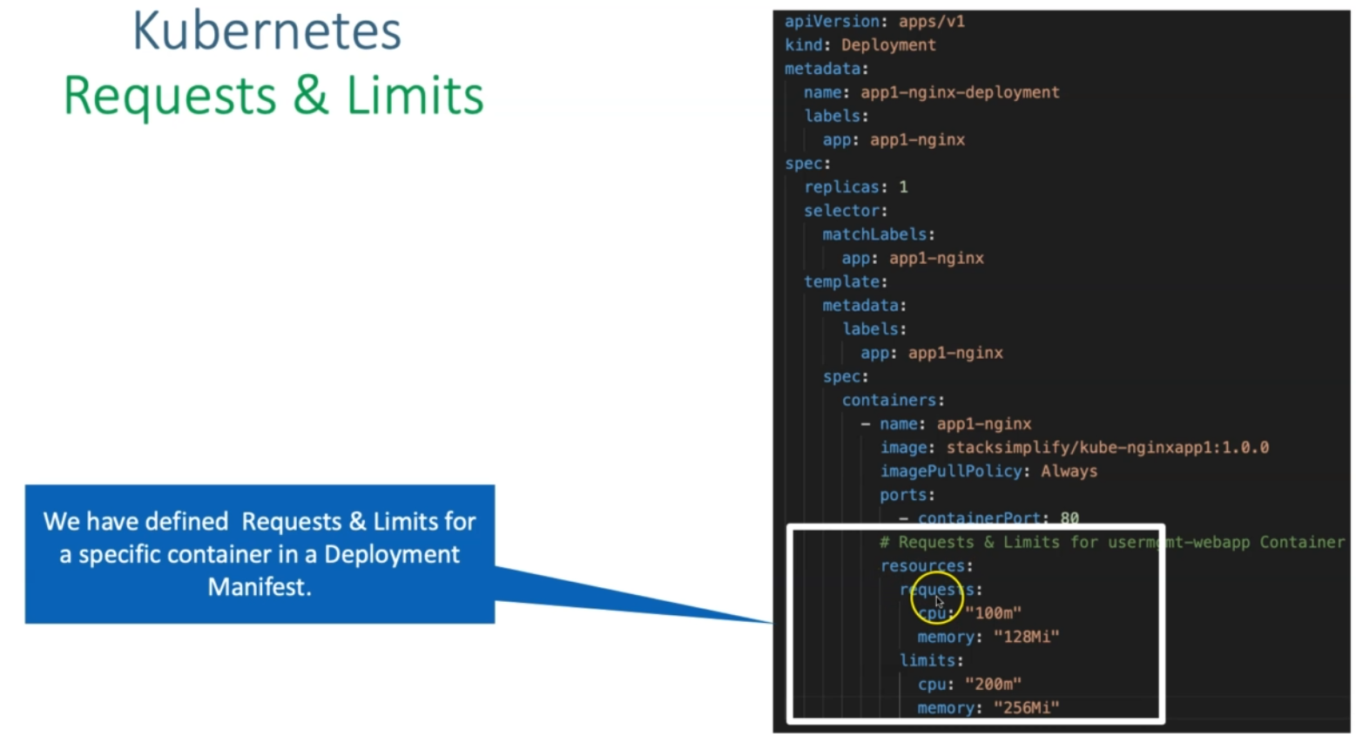

Slide 95
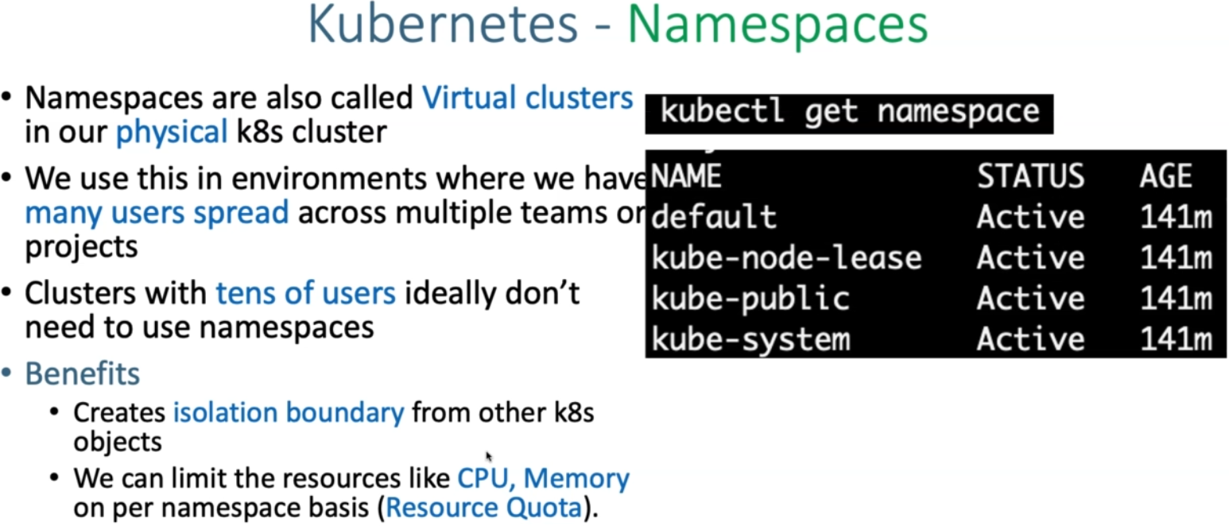

Slide 96
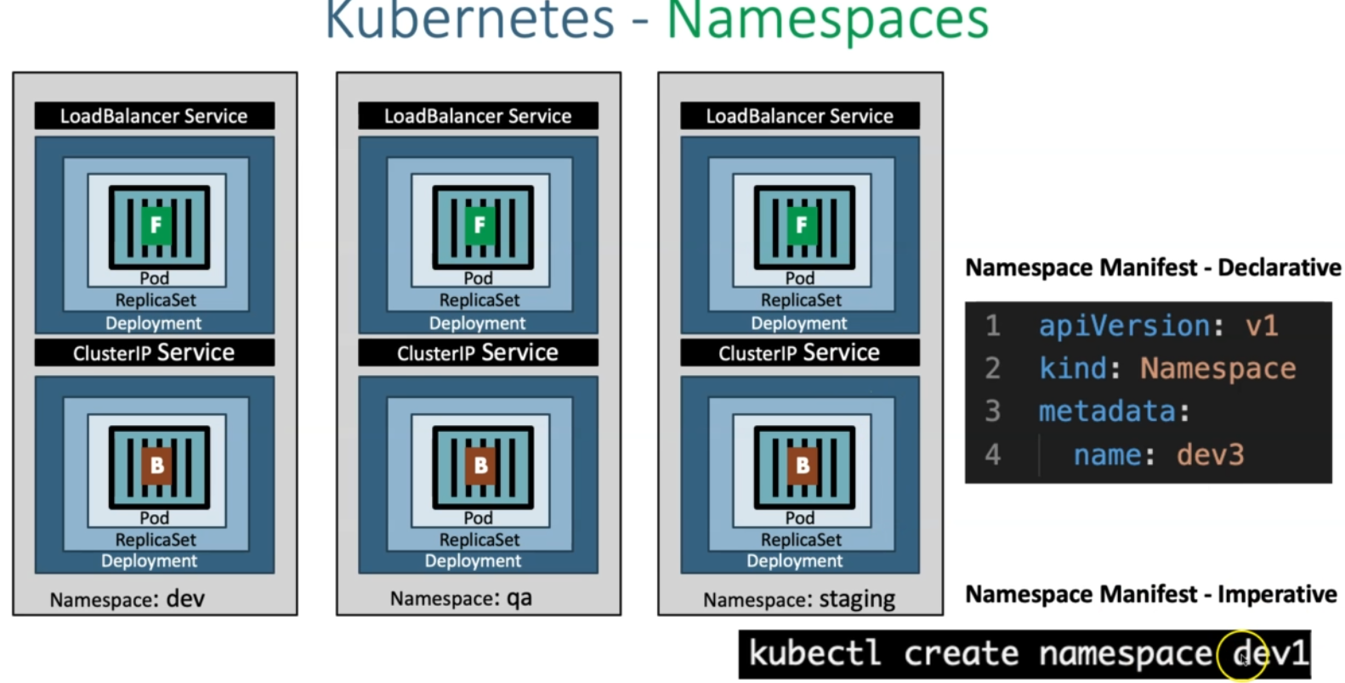

Slide 97
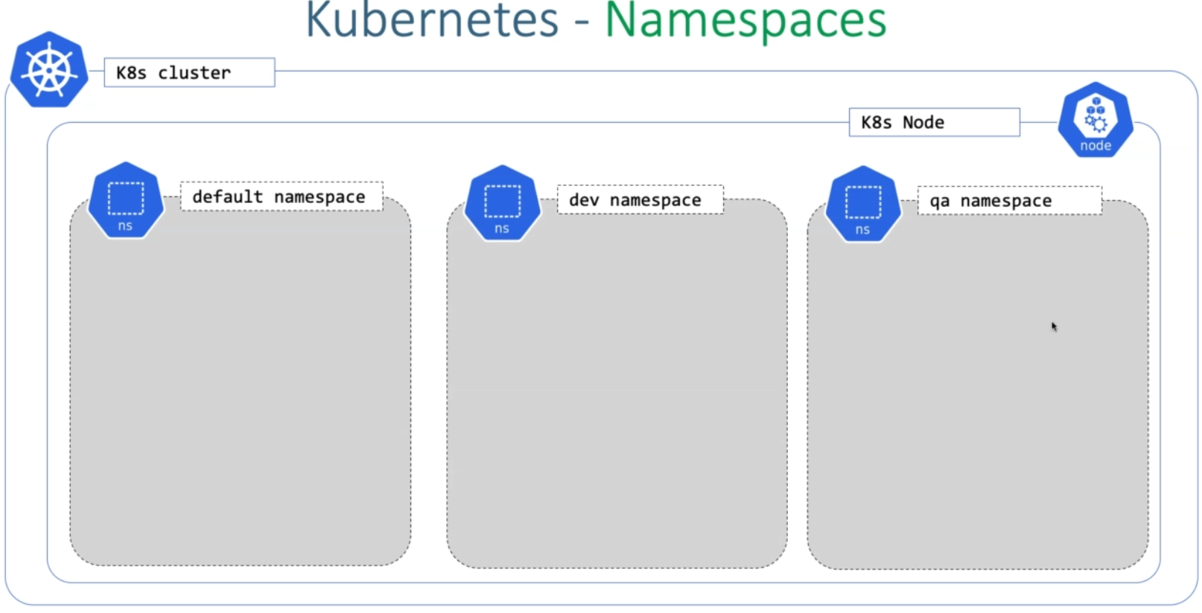

Slide 98


Slide 99


Slide 100
Create Namespace
# List Namespaces
kubectl get ns
# Craete Namespace
kubectl create namespace <namespace-name>
kubectl create namespace dev1
kubectl create namespace dev2
# List Namespaces
kubectl get ns
Deploy All k8s Objects to default, dev1 and dev2 namespaces
# Deploy All k8s Objects
kubectl apply -f kube-manifests/
kubectl apply -f kube-manifests/ -n dev1
kubectl apply -f kube-manifests/ -n dev2
# List all objects from default, dev1 & dev2 Namespaces
kubectl get all -n default
kubectl get all -n dev1
kubectl get all -n dev2

Slide 101


Slide 102


Slide 103


Slide 104


Slide 105


Slide 106


Slide 107


Slide 108


Slide 109


Slide 110


Slide 111


Slide 112


Slide 113


Slide 114


Slide 115


Slide 116


